Slide 1
Controlling Large and Small Systems Using TINE
(your own mileage may vary …)

Slide 2
Background Information
When operators/experimenters talk about the control system they are not talking about
  “EPICS”, “TINE”, “TANGO”, “DOOCS”, etc.
They are talking about the ‘system’ controlling their machine :
  i.e. their accelerator, beamline, experiment, etc.
EPICS, TINE, TANGO, DOOCS provide a control system framework.
  There’s no ‘setup.exe’ that scopes out what you’re trying to control and what hardware you’re using !

Slide 3
Background Information
Control System Framework:
  Some person(s) will need to be familiar with the ‘framework’
    setup configuration databases
    make hardware decisions
    find and fix specific problems (that may or may not have anything to do with the ‘framework’ chosen).
    etc.
  Pragmatic solutions to problems allow for multiple frameworks
    That’s why we have:
      epics2tine
        (the first translator on the block! – PCaPAC 2000, ICALEPCS 2001)
      tango2tine
      epics2tango
      etc.

Slide 4
Control Systems101
Control Systems (one way or another) have to deal with …
Distributed end points and processes
Data Acquisition (front end hardware)
Real-time needs (where necessary)
Process control (automation, feedback)
Central Services (Archive, Alarm, Name Resolution, …)
Security (who’s allowed to do what from where?)
States (Finite State Machines, sequencing, automation…)
Time synchronization (time stamps, cycle ids, etc.)
Databases (configuration, machine data, post-mortem data, …)
Statistics (control system itself, operation, …)
Logging (central, local, application, …)
Data transport (data flow, control system protocol, scalability)

Slide 5
TINE: A Quick Tour
Three-fold Integrated Networking Environment
  (->Keep your eye on the word “Integrated”)
Mature Control System
  CERN Isolde Spin-off (~1991)
  All the usual central services :
    Archive, Alarm, Naming, Security, Logging, etc.
Small Footprint
  TINE Kernel written in C (just like your Operating System) or Java
  Berkeley Sockets (NO SunRPC, CORBA, or other 3rd Party dependencies !)
  Either Single-threaded or Multi-threaded
Easy to Install
High Performance
Plug and Play (add new elements on the fly)
Available on large number of platforms
  native on all the UNIXes (Linux and MAC), Windows, + VxWorks, VMS, DOS, NIOS
  java, .NET, LabView, MatLab, Python, etc. (client and server!)
Scalable to very large machines !
seriously multi-platform!

Slide 6
TINE Usage
DESY (Hamburg) “ground zero”
  HERA
    A very large machine (on-ice since 2007)
  LINAC2, DESY2
  PETRA3, DORIS
  REGAE
  FLASH
  DOOCS
    embedded in DOOCS since ~2001
    will replace SunRPC as de-facto protocol for XFEL
    => FermiLab, Cornell
Zeuthen (Berlin)
KEK (Japan)
  Photon Factory beamlines (add-on to STARS system)
EMBL (Hamburg)
GKSS, HASYLAB (Hamburg)
MedAustron (Austria)
Thomson Broadcast (Switzerland)
ImTech Electronics (Netherlands)
Berthold Technologies, GmbH
COSYLAB (Slovenia) “expertise”
???

Slide 7
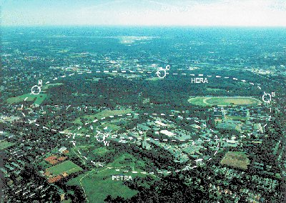
Controlling large machines …

Slide 8
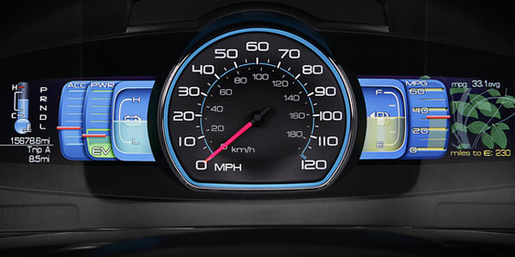
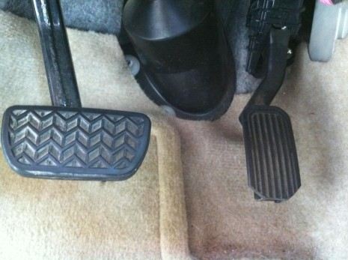
Or smaller machines ….

Slide 9
bits and bytes … or rubber bands and paper clips …
Basically:
  Buttons and knobs to issue instructions …
  Displays to let you know what’s going on …
Can use one of these control system frameworks for
  particle accelerators
    circular, linear
  beamlines
  telescopes
  tokamaks
  etc.
of course:
  different strategies, solutions, services, hardware, etc.
but they all have:
  alarms, archiving, security, data-flow, automation, …
  … and someone sits at a console …

Slide 10
Control System Models (a review)
Model I: Database Model
  EPICS, VISTA (i.e. VSystem not the OS)
  Control system data are elements in a database.
  Transfer Process Variables
    pvData have names
    Actions are ‘get’, ‘set’, ‘monitor’
  BUT: Some things aren’t variables at all !
    e.g. command and calls
an epics pv: “G47c:K:KL:B12:TR4_02_ai”

Slide 11
Control System Models (a review)
Model II: Device Server Model
  TANGO, DOOCS, STARS*, TINE*
  Elements are controllable objects managed by a device server.
  Instance of such an object is a device, with a hierarchical name.
  Actions pertaining to a device given by its properties !
    i.e. get, set, monitor, call some property OR command
  BUT: some things aren’t devices !
    e.g. “*” is NOT a device.
  AND: some services are Property-orientated !
TINE device server address: “/PETRA/BPM/BPM_SWR_13/Orbit.X”
context
server
device
property

Slide 12
Control System Models (a review)
Model III: Property Server Model
  STARS*, TINE*
  Elements are services with properties (or methods)
  Same basic hierarchy as Device Server Model
  Properties have Keywords
    (instead of Devices having Properties)
  e.g. Middle layer services
    Name Server
    Central Alarm Server
    Central Archive Server
    CDI Server
    etc.
  BUT: Not everything divides cleanly into Device Server or Property Server !
TINE property server address: “/HASYLAB/Petra3_P12vil.CDI/BS_0/STELLUNG”
context
server
keyword
property

Slide 13
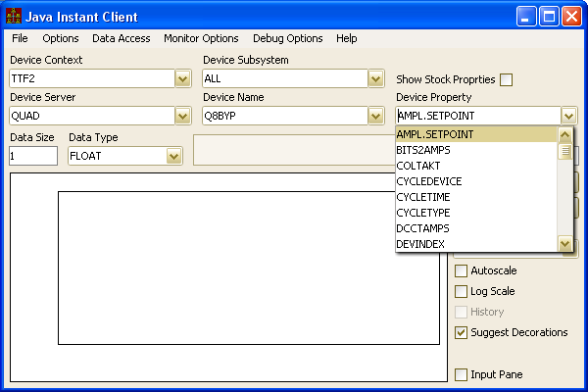
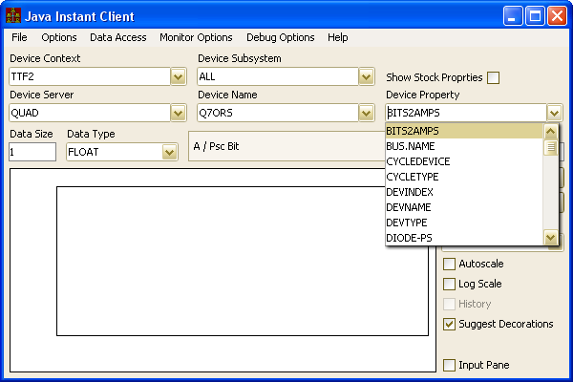
Servers
Device Servers
  Instances of hardware devices
  Hierarchy is flat or device-oriented
    Each device supports a set of properties
  The device has properties !
  e.g. BPM, BLM, VAC.ION_PUMP, …
Introducing the Instant Client :
- a control system browser

Slide 14
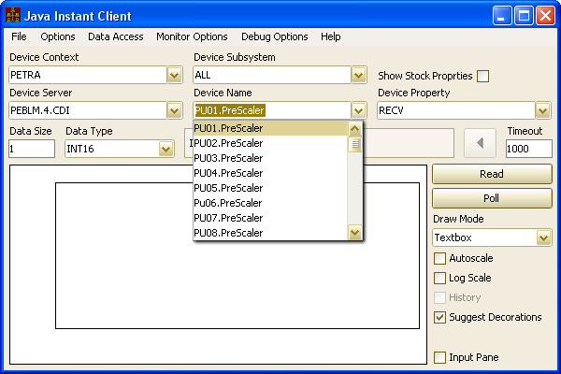
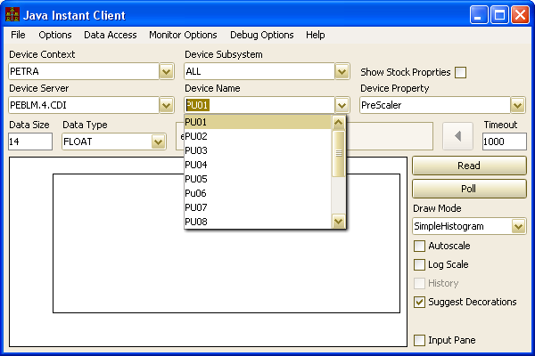
Servers
Property Servers
  Services accessed by properties
  Hierarchy is flat or property-oriented
    Each property supports a set of ‘devices’ (i.e. keywords)
  The server has properties !
  e.g. ARCHIVER, CAS, any CDI server, …
Now, maybe you understand why the Instant Client does NOT use device-tree browsing but instead combo boxes!

Slide 15
Data Flow
Okay. That’s how a client addresses some remote thing in the control system!
How do I send the remote thing a command?
  Security issues.
  Classic ‘transaction’
How do I monitor the information from that remote thing?
  How much data is involved (the payload)?
  How fast does the update rate need to be?
  How many other clients are doing this?
  => load on server, load on network (mostly from monitoring)
What API is available?
The Control System Protocol

Slide 16
Data Flow Memes : 0th Order
Transaction-based Client-Server
Transaction-based Client-Server
  Client asks, server responds
  KISS (no management tables) !
  Suitable for small systems
  Server Load:
Keep It Simple, Stupid !
L_{S} ~ N_{C} X N_{T} X L_{D} X U_{T}
L_{S} = Load on Server/sec (CPU cycles spent)
N_{C} = Ave. num clients
N_{T} = Ave num transactions / client
L_{D} = Ave Load handling a dispatch
U_{T} = Ave update rate
Threads ?
Multi-Core ?

Slide 17
Data Flow Memes : 0th Order
Transaction-based Client-Server
Network Load:
L_{N} ~ N_{C} X N_{T} X P_{T} X U_{T} X 2
L_{N} = Load on Network (bytes/sec)
N_{C} = Ave. num clients
N_{T} = Ave num transactions / client
P_{T} = Ave Transaction Payload
U_{T} = Ave update rate
2 = outgoing + incoming payloads ~equal
Threads ?
Multi-Core ?
Increase Scalability => Reduce the Load
  Reduce any of these factors !

Slide 18
Data Flow Memes : 1st Order
Contract-based Publish-Subscribe
Contract-based Publish-Subscribe
  Kiss KISS goodbye !
    Contract and connection management
    Transaction => managed contract + table of clients
    Larger systems
    Server Load :
L_{S} ~ N_{T} X L_{D} X U_{T}
L_{S} = Load on Server/sec
N_{T} = Ave num transactions / client
L_{D} = Ave Load handling a dispatch
U_{T} = Ave update rate
N_{C} (Number of Clients) no longer a factor !

Slide 19
Data Flow Memes : 1st Order
Contract-based Publish-Subscribe
Network Load:
  Similar, but:
    Factor 2 gone!
    Can use ‘Send on Change’ to reduce U_{T}
    Can use multicast to reduce N_{C}
L_{N} ~ N_{C} X N_{T} X P_{T} X U_{T}
L_{N} = Load on Network (bytes/sec)
N_{C} = Ave. num clients
N_{T} = Ave num transactions / client
P_{T} = Ave Transaction Payload
U_{T} = Ave update rate
IF your framework will let you multicast !
Great Benefit to Scalability!
  BUT: API can still allow inefficiency !
  AND: Who is doing the programming ?

Slide 20
Data Flow Memes : 2nd Order
Contract-Coercion
Analyze the transaction request
  Map to an existing contract if possible
  Anticipate future requests and renegotiate the contract with the client
    e.g. “if he’s asking for BPM#1, then he’ll probably want BPM#2 as well”
    Make use of Multi-Channel Arrays where possible
      (property has registered as an MCA)
    Make use of structured where possible
      (property has registered as a STRUCT)
  Guide synchronous and asynchronous acquisitions
    Don’t monitor ‘static data’
    Don’t synchronously poll monitorable data.
    Trap ‘foolish’ update intervals
  KISS is a distant memory
Yes, you can send structures in TINE !

Slide 21
A Server takes control of its Clients
Example: doing 1 thing for 1 effective client instead of 600 things for 10
A client tries to synchronously poll a single channel (e.g. a ‘get’ in a timer) …
It all happens under the hood ….
Client
Give me property “Pressure” for pump “OL146.2”
Ok then, monitor “Pressure” for pump “OL146.2”
Ok then, monitor “Pressure” for all pumps
Ok then, I’ll listen for the multicast
Server
No! You’ll have to monitor this !
No! You’ll have to monitor the entire MCA
Ok, but I’m going to multicast it!

Slide 22
A Server takes control of its Clients
Example: Nipping superfluous polling in the bud …
A client tries to poll a static property …
It all happens under the hood ….
Client
monitor the property “Pressure.Units”
Ok, thanks. What was I thinking? I’ll close my link!
Server
No way! I’ll give you the value, but this is static information! It’s “mbar” now, it was “mbar” yesterday, and it’ll be “mbar” tomorrow, too !

Slide 23
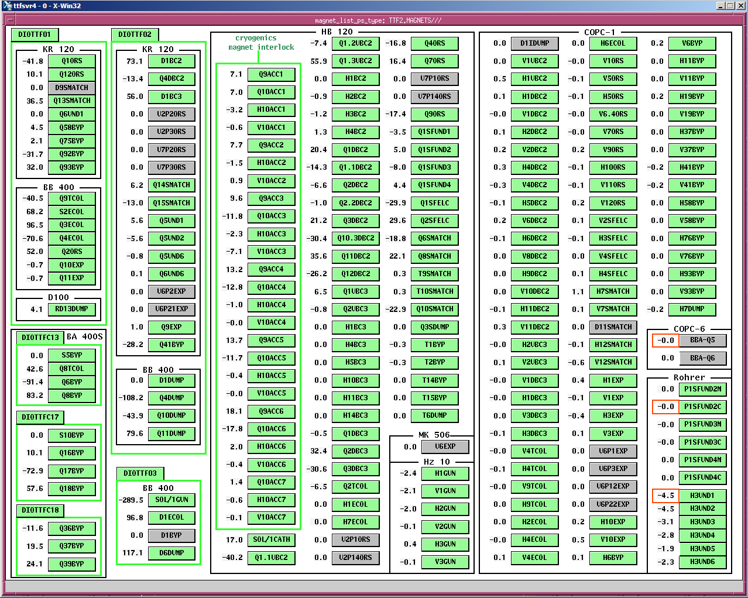
FLASH DDD PS Panel with TINE Multichannel Polling
10 connections/property (was ~260)
50 contracts (was > 1000)
STEERER/SHGROUP (57)
STEERER/SVGROUP (48)
QUAD/QDGROUP (40)
DIPOLE/DIGROUP (19)
UNDULATOR/UNGROUP (7)
TTMAG-AB/GROUP
(PC104, 41 elements)
MAIN/MNGROUP (6)
SEXT/SXGROUP (3)
TTMAG-CD/GROUP
(PC104, 41 elements)
SOL/1GUN (1)
SUN (multi-server)

Slide 24
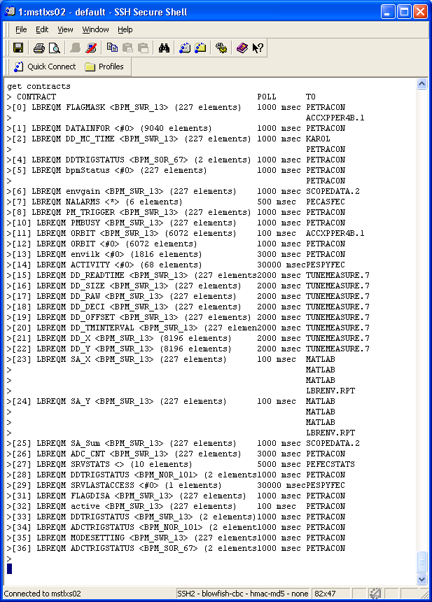
PETRA BPMs
227 Libera modules
~ 15 Client
~ 35 Contracts
1 run-of-the-mill PC with Ubuntu Linux
~ 7% CPU load !

Slide 25
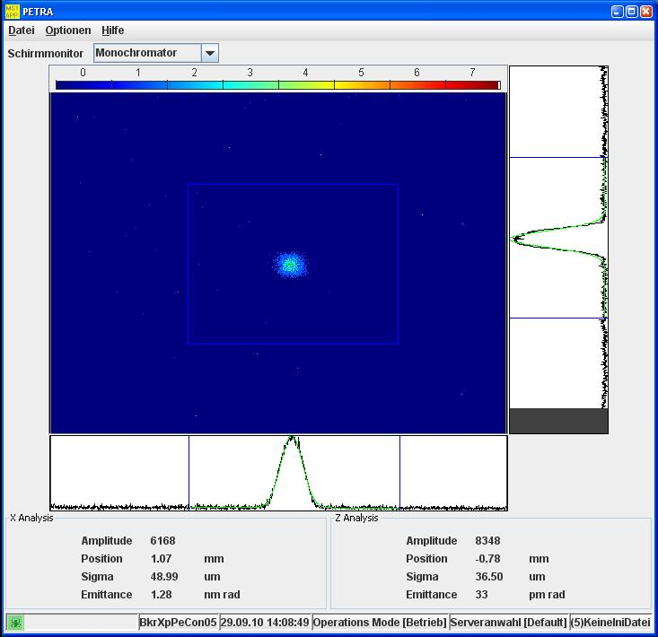
Transaction Coercion
PETRA3 Video Example:
  Mixed Gbit/100-Mbit Net
  Large images (large P_{T})
Tune the transport Parameters !
  Enforce multicast
  Minimum polling interval
  Redirect non-Scheduled Property to Scheduled Property
N_{T} = 1, N_{C} = 1

Slide 26
TINE Low-Level Support …
“Do it yourself” + your hardware API
  Use those Windows drivers your hardware comes with!
  You’ve already got a stand-alone system: how do you connect it to the control system?
EPICS IOCs (asyn drivers) + Epics2Tine
LabView VIs + TINE LabView
DOOCS + DOOCS API
CDI (Common Device Interface) !!!
  Bus plugs for CANOpen, SEDAC, RS232, SiemensPLC, TwinCatADS, EtherCat, Libera, … (asyn?)
TICOM (TINE CanOpen Manager)

Slide 27
Security at Multiple Levels
Everyone can READ
  (if you make it through the firewalls …)
Access control for commands
  At the device server
  For the specified property
  For the specified device
  User control (or user groups)
  Network address control
Access Locks
  One specific client on some host gets a lock token
Exclusive Read access also available

Slide 28
IDE Frameworks …
Develop rich clients using :
  C, C++
  .NET (C#, VB, C++), (visual studio, mono)
  java (eclipse or netbeans + acopbeans)
  Lazarus (DELPHI) (visual pascal)
  Qt, PyQt
  MatLab
  LabView
GUI Panels with :
  jddd (Java DOOCS Data Display)
  CSS (Control System Studio – not Cascading Style Sheets)
  COMA (Container Object MAnager)
  Web2C

Slide 29
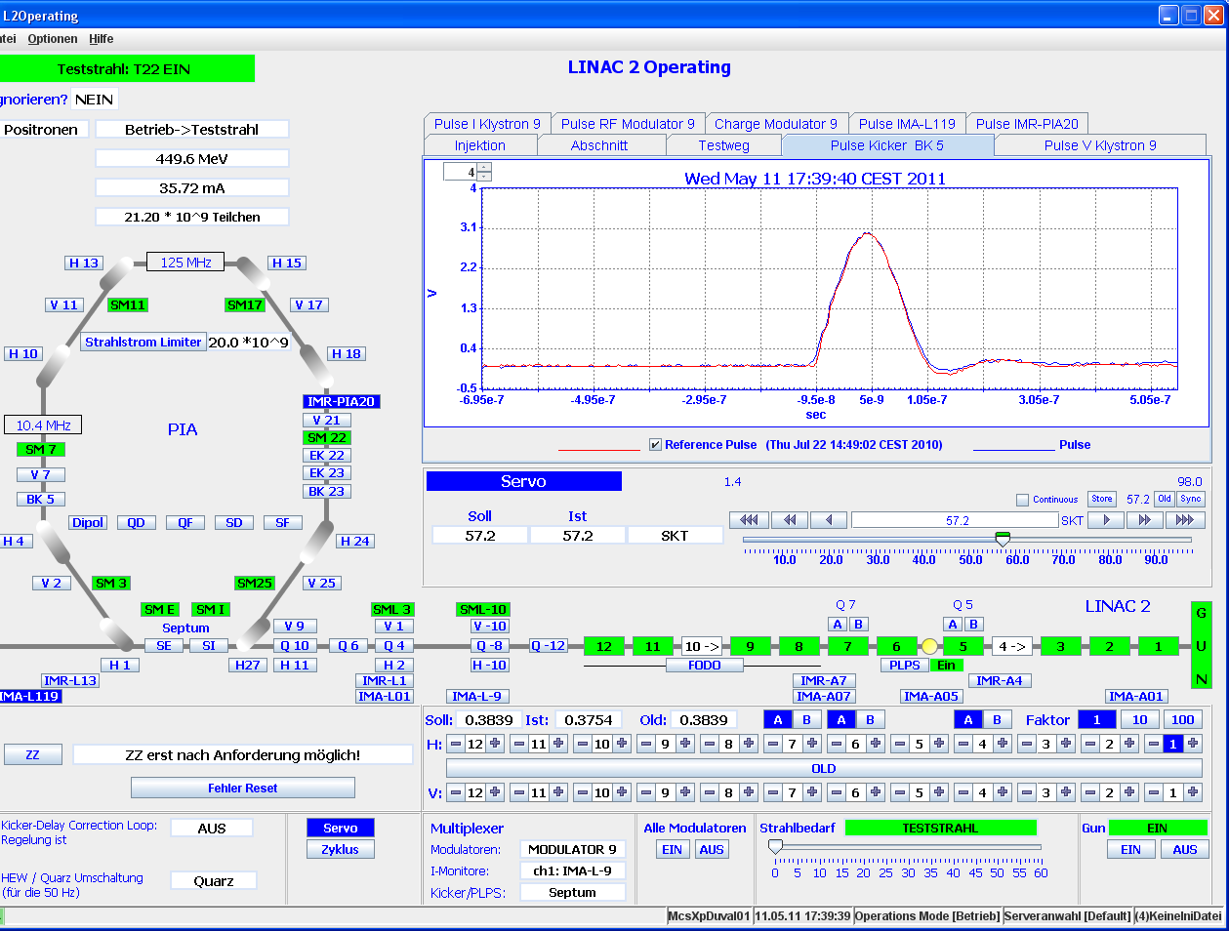
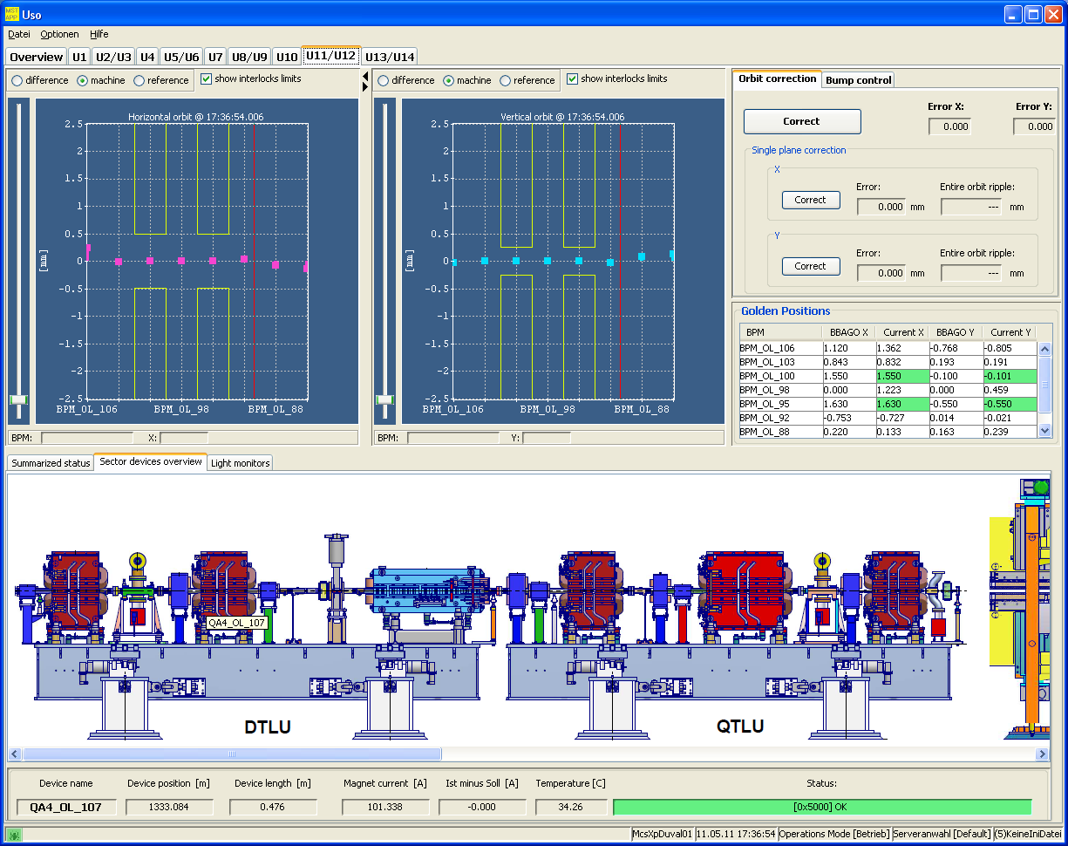
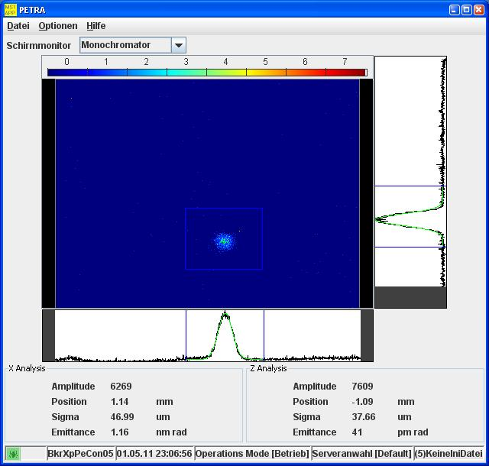
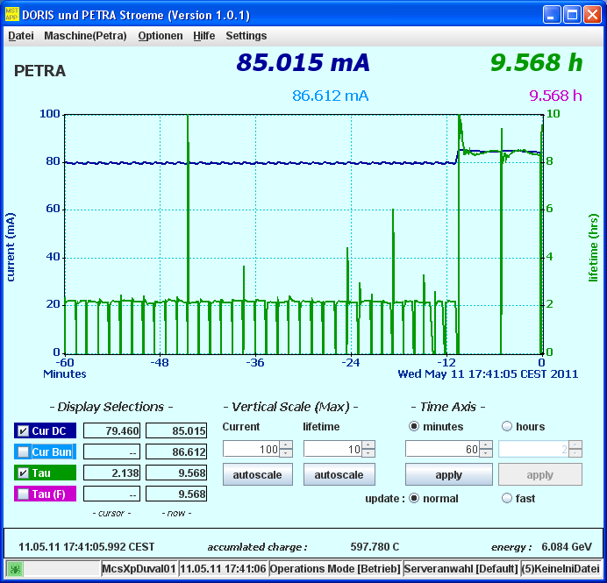
TINE Clients : Rich Clients (java)
etc. …
How ‘important’ are synoptic displays ?

Slide 30
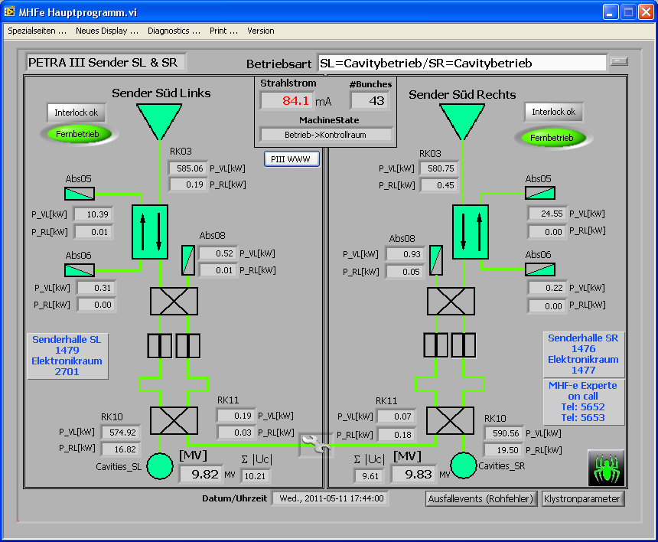
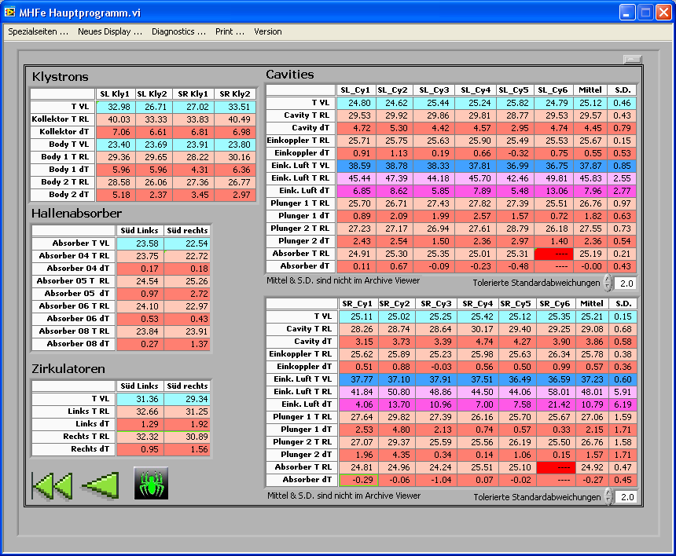
TINE Clients: Rich Clients (LabView)

Slide 31
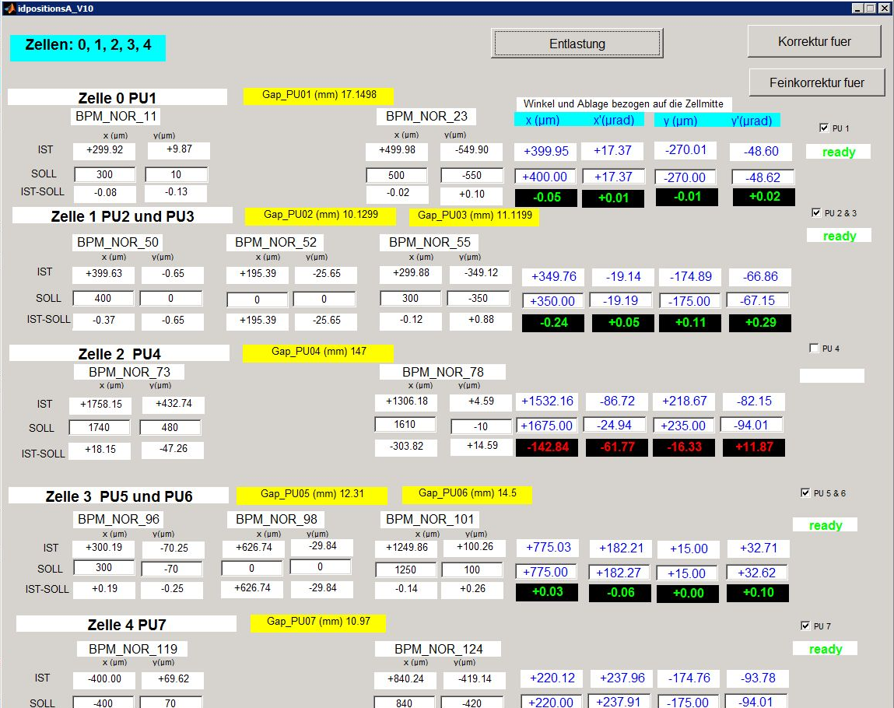
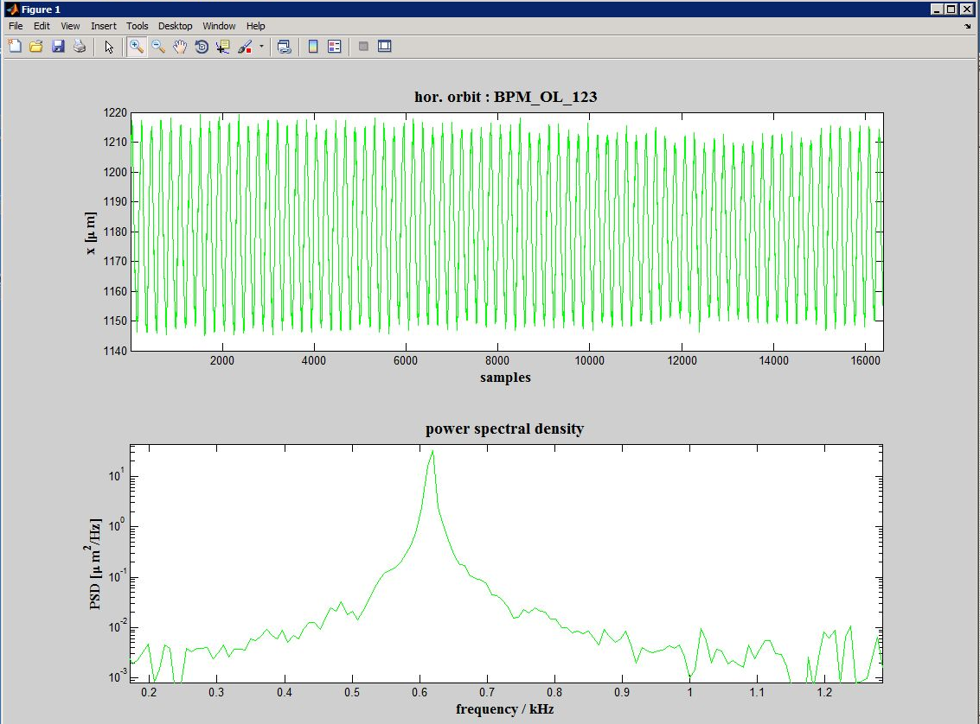
TINE Clients: Rich Clients (MatLab)

Slide 32
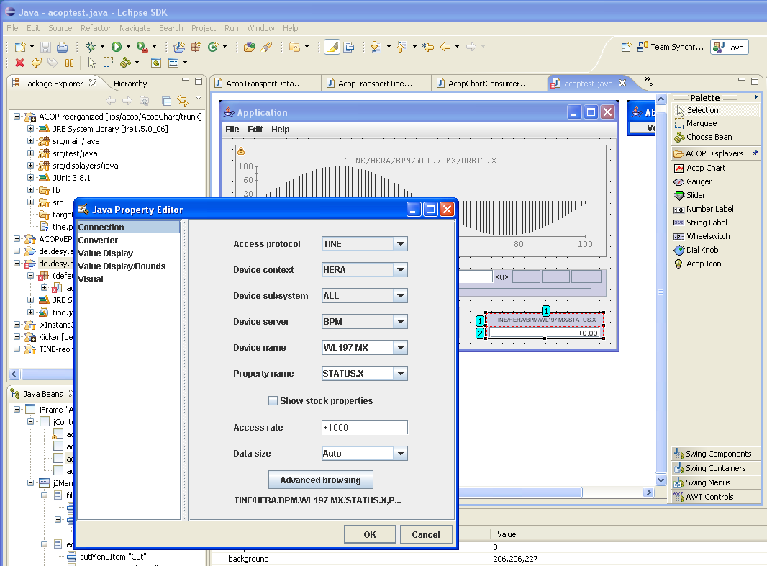
TINE and Java ACOP
(for rich clients)
No Frameworks !
Use Eclipse, NetBeans, or whatever …
Browse Control system at design-time with property panels or customizer …

Slide 33
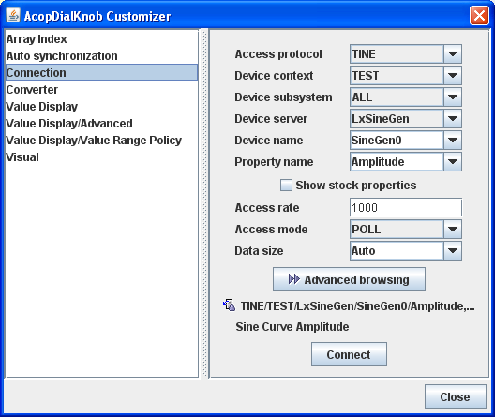
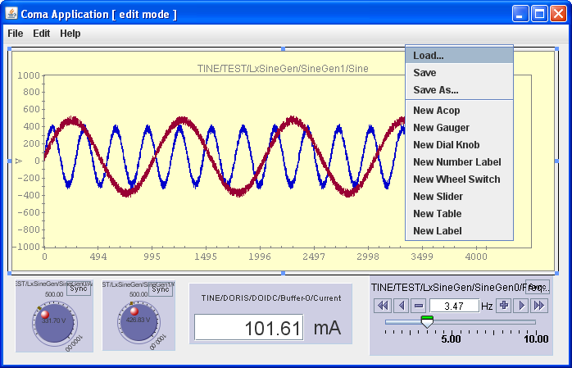
TINE and Java ACOP + COMA
(for simple clients)
No Frameworks !
Lightweight!
Just start a coma application (e.g. an empty coma application)
Browse Control system at run-time with customizer …

Slide 34
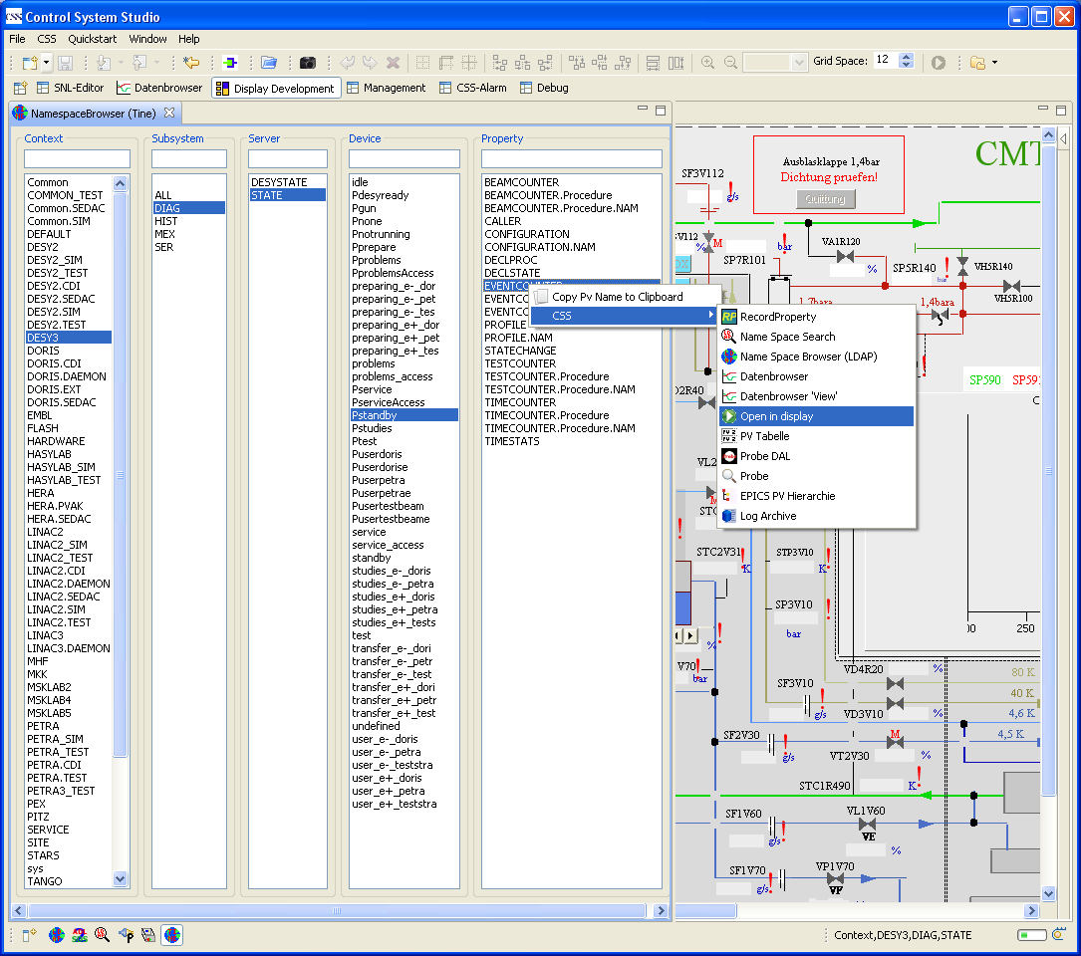
TINE and Control System Studio (CSS)
Call up:
  Display
  PV-Table
  ……
Drag and Drop
  Into PV-Table
  Into Display
  (edit mode)
No DAL support for PV-Table - yet
Namespace Browser (TINE)
See: http://adweb.desy.de/mcs/TINE_Users_Meeting/2008Dec05/CSS-TINE%20Meeting-2008-12-05-2008-12-05.pdf

Slide 35
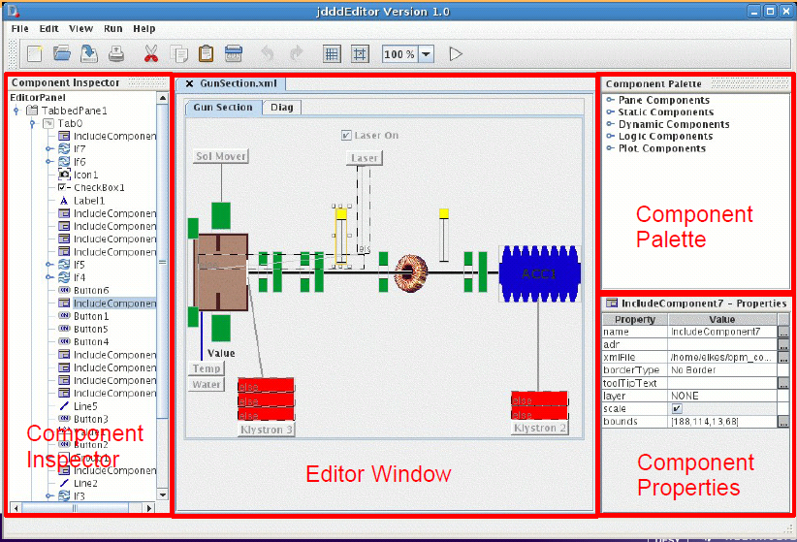
TINE and jddd
See: http://adweb.desy.de/mcs/TINE_Users_Meeting/2008Nov07/jdddTalkNew.pdf

Slide 36
Server-Side development
One-pass server wizard for
  Server configuration database
    can be used for LabView servers
  C project (suitable for C++)
  VB 6
  2nd pass makes copy of previous code but does NOT preserve changes!
Java server wizard
  Simplified functionality for ‘most use-cases’
Or
  copy-paste and read the documentation
Remarks:
  CDI servers are entirely database driven (and there’s a CDI database editor)
  LabView cannot be generated BUT the API is easy!

Slide 37
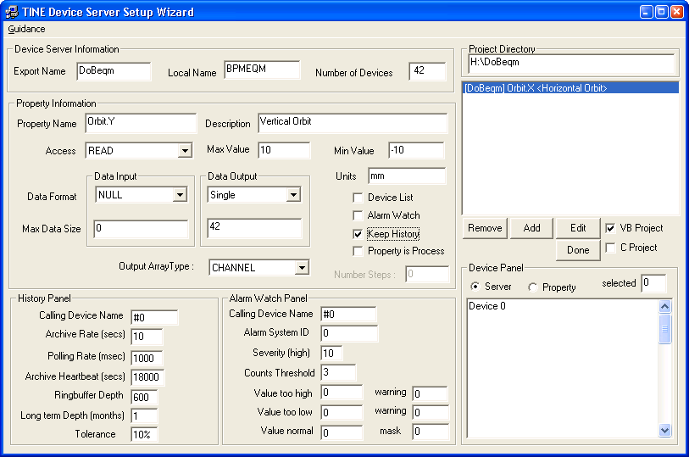
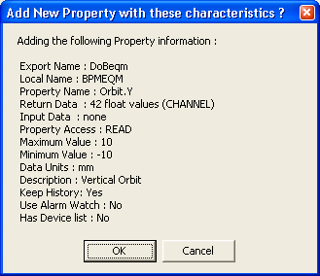
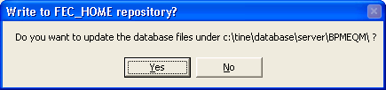
Standard Device Server Wizard
(in need of modernization! – dates back to 1999)
C, VB or LV
(leave unchecked)

Slide 38
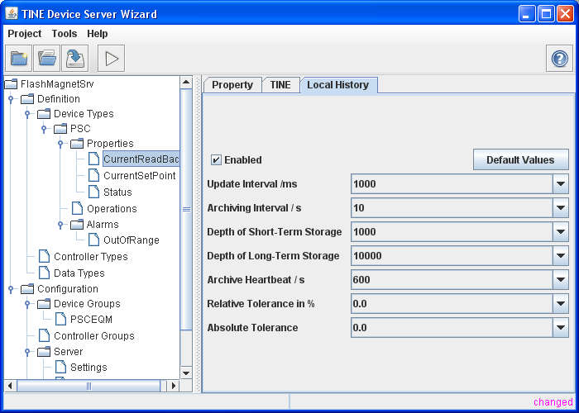
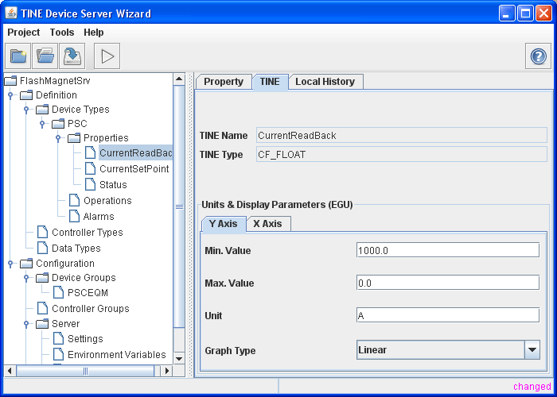
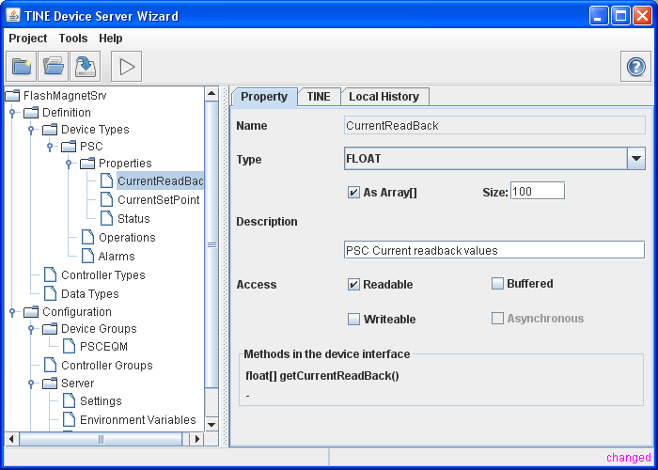
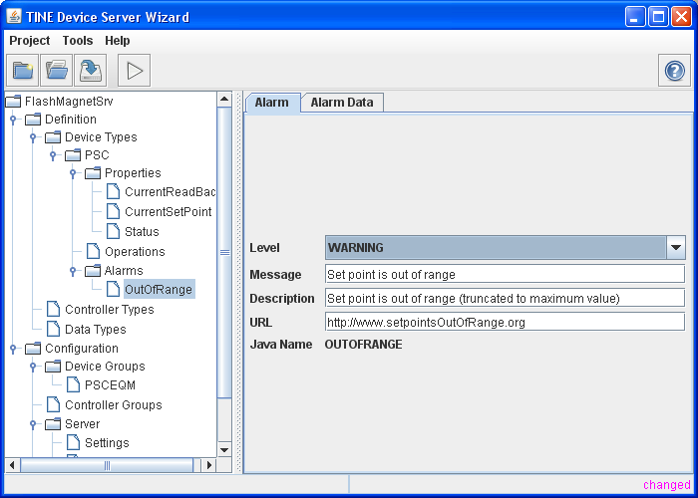
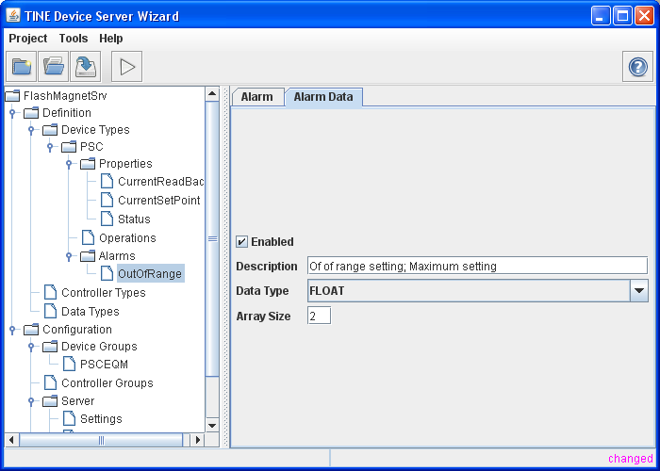
Java Device Server Wizard …

Slide 39
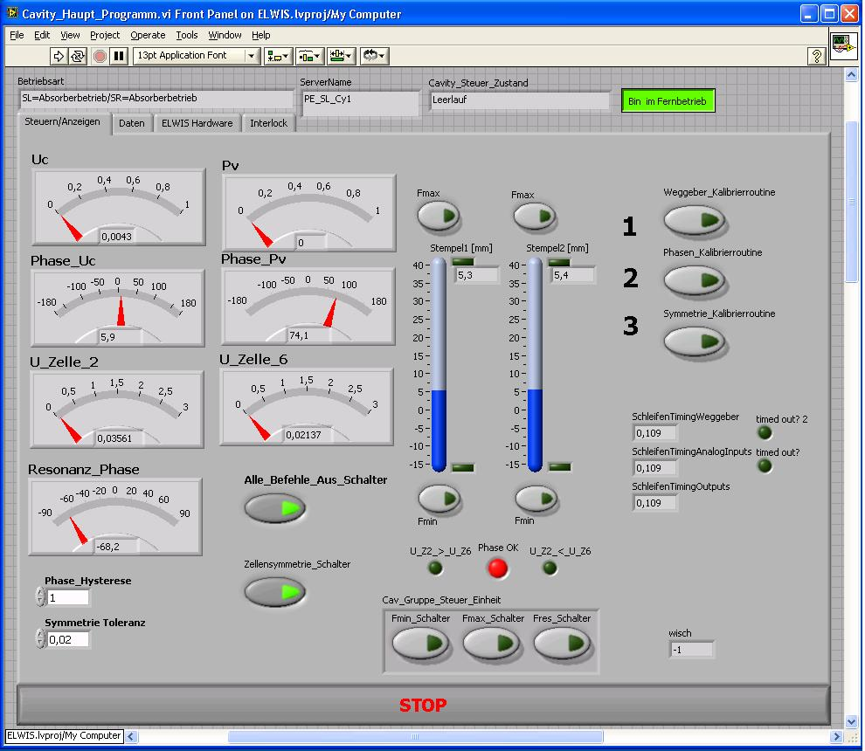
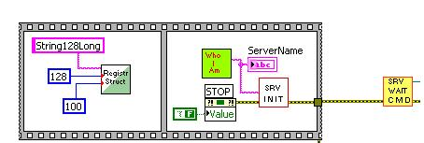
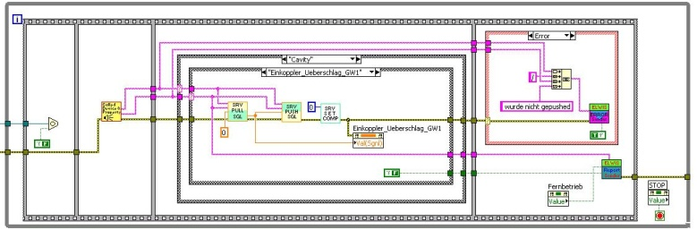
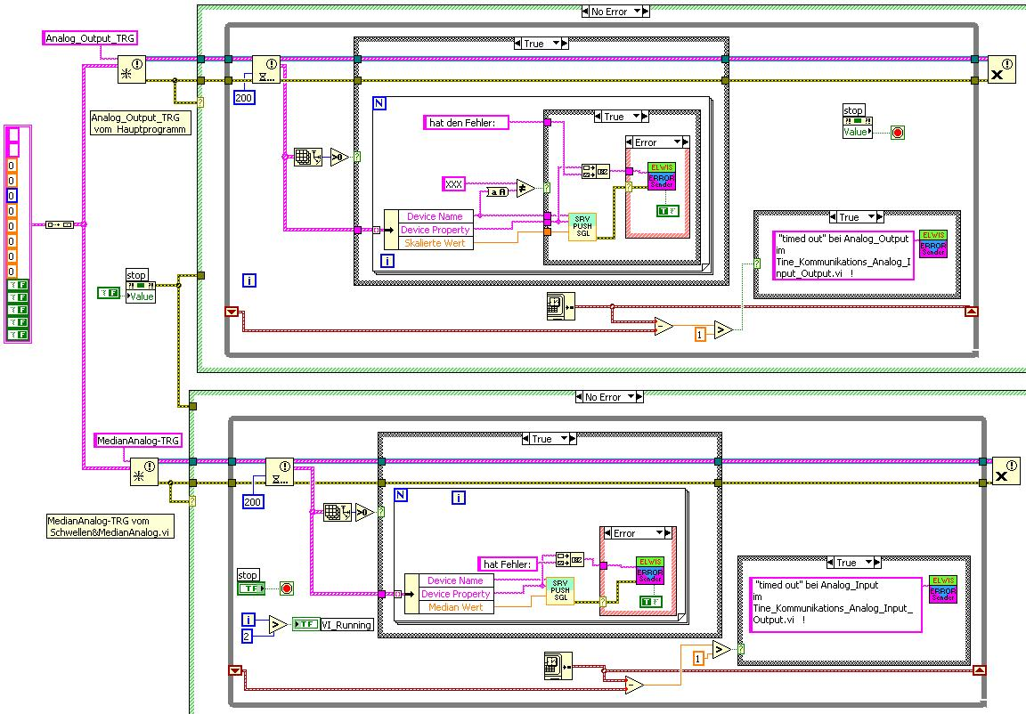
LabView Servers (RF Cavities)

Slide 40
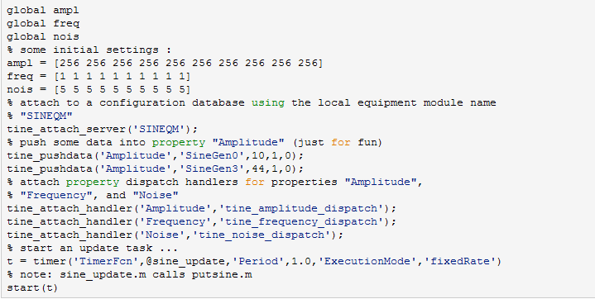
MatLab Servers
MatLab server using configuration files …
Attach to database via equipment module “SINEQM”
Supply a property and device with data
Register dispatch handlers for settings changes
Start a background task

Slide 41
Central Services
Naming Services
  Plug-and-play (Equipment Name Server)
Archive Services
  Machine archive
  Event (Post-Mortem) archive
  Local Histories
Logging (central and local)
Alarm Services
  Central Alarm Server
State Services
  Declared Machine State
  Operation History counters (availability)
Machine ‘Globals’
Synchronization
  Time synchronization server
  Cycler
BEAUTY and the BEAST? I don’t think so !

Slide 42
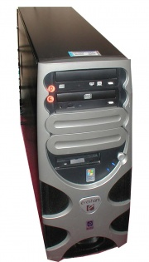
TINE ENS: Plug and Play
Does BPM already exist for PETRA?
  -> Yes : Is same address as already registered?
    -> Yes: Accept and increment reboot count
    -> No:
    Is the currently listed BPM.P for HERA running ?
    Yes : Refuse and send “in-use” message
    No : Accept and update database
  -> No : Accept and update database
Equipment Name Server (ENS)
I want to be known to the system as “BPM” in the context “PETRA”
Forward accepted requests to secondary name servers

Slide 43
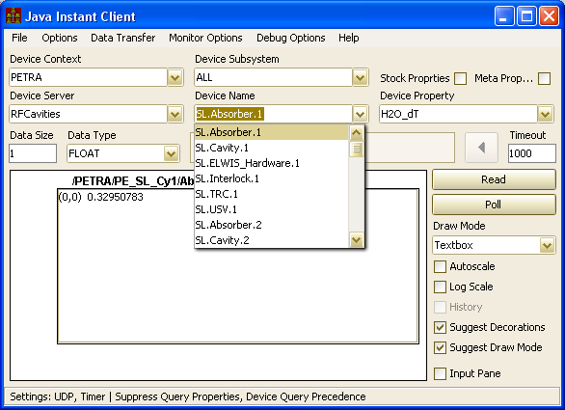
Plug and Play (joining a group)
PE_SL_Cy1 registers with ENS as before
PE_SL_Cy1 registers group RFCavities with GENS
  Does group RFCavities exist ?
  Yes:
  Is PE_SL_CY1 a member?
  Yes: Update device list if different
  No: join group
  No:
  Create Group and register Group as Server in
  Context PETRA with the ENS
I want to be known to the system as “PE_SL_Cy1” in the context “PETRA” and join the group “RFCavities”
Clients see a “Server” called “RFCavities”
Selected Device is redirected to the appropriate physical server.

Slide 44
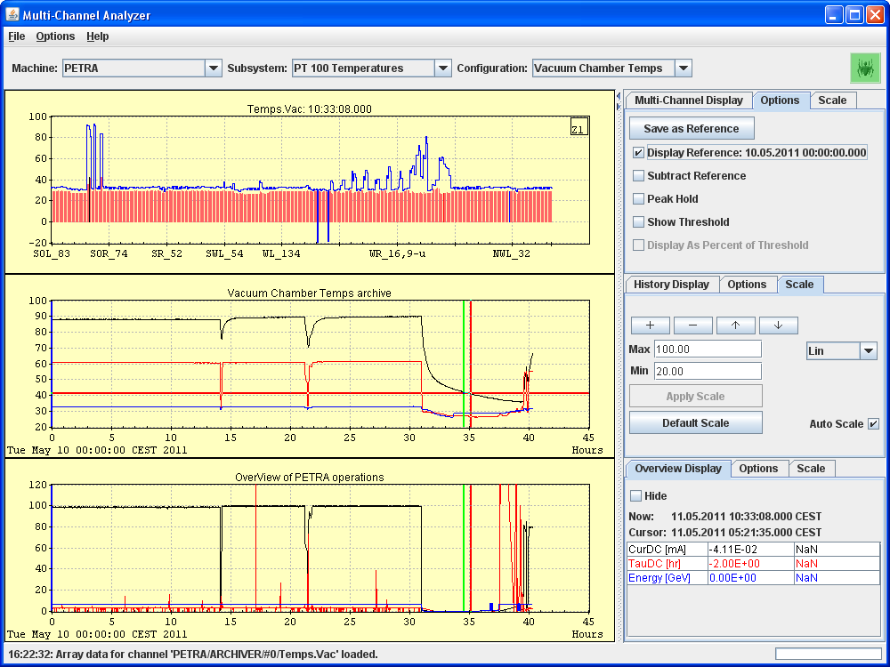
TINE Archive System
(lickity split data retrieval !)
Example: Multi-Channel Analyzer:
All temperatures as “snapshot” (vs. selected reference)
Histories of selected sensors:
Histories of machine operation parameters:
Archive call < 100 msec

Slide 45
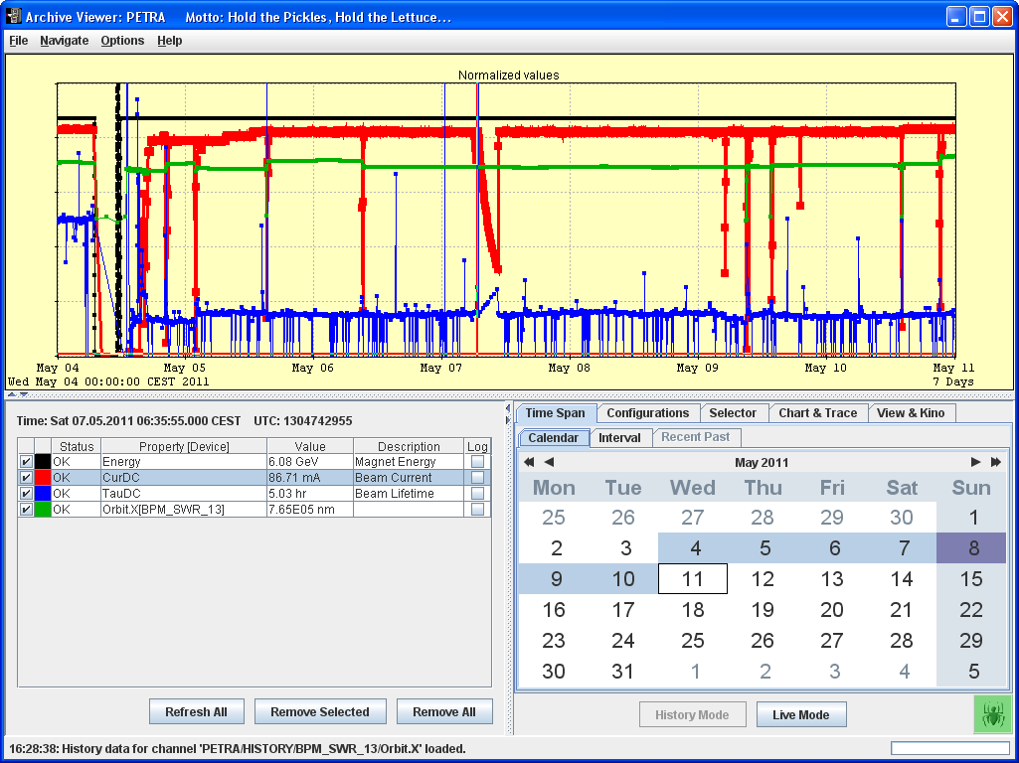
TINE Archive System
Browse and add trends of desired machine parameters to display !

Slide 46
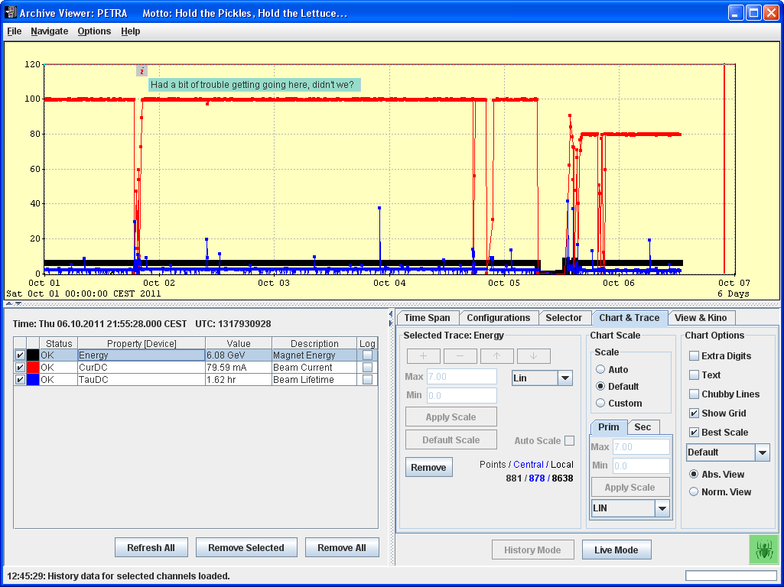
Archive System
Found an annotation !
Enough points from central archive !

Slide 47
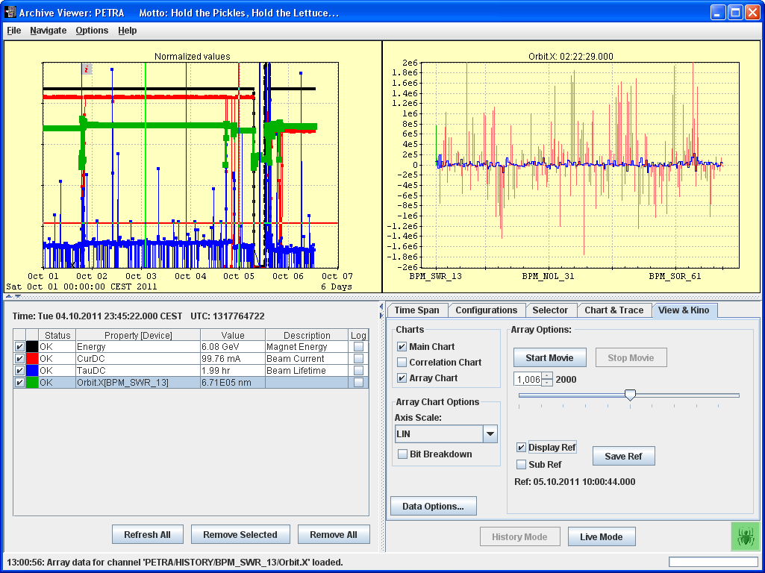
Archive System

Slide 48
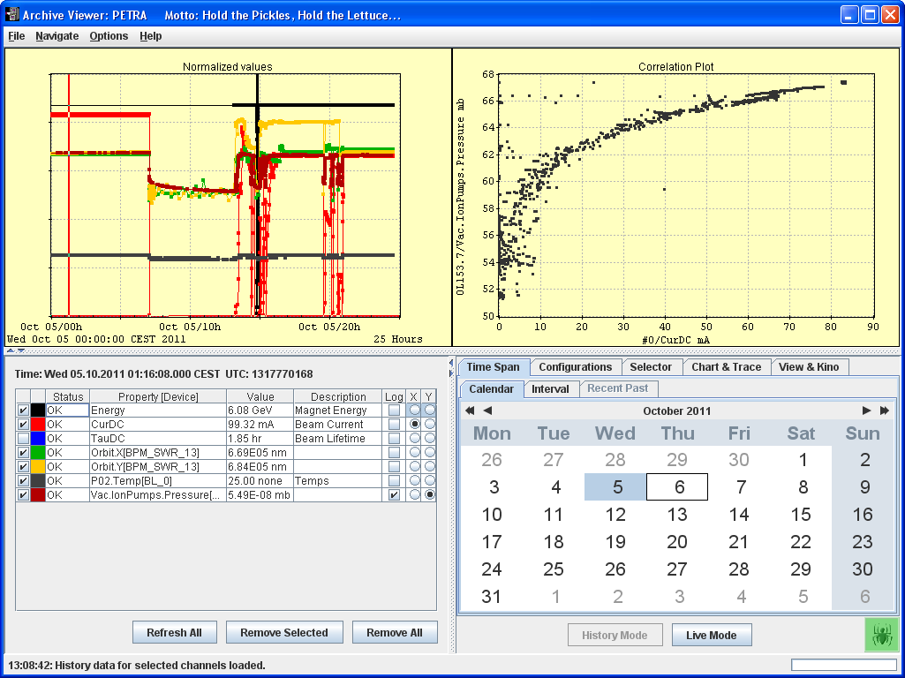
Archive System

Slide 49
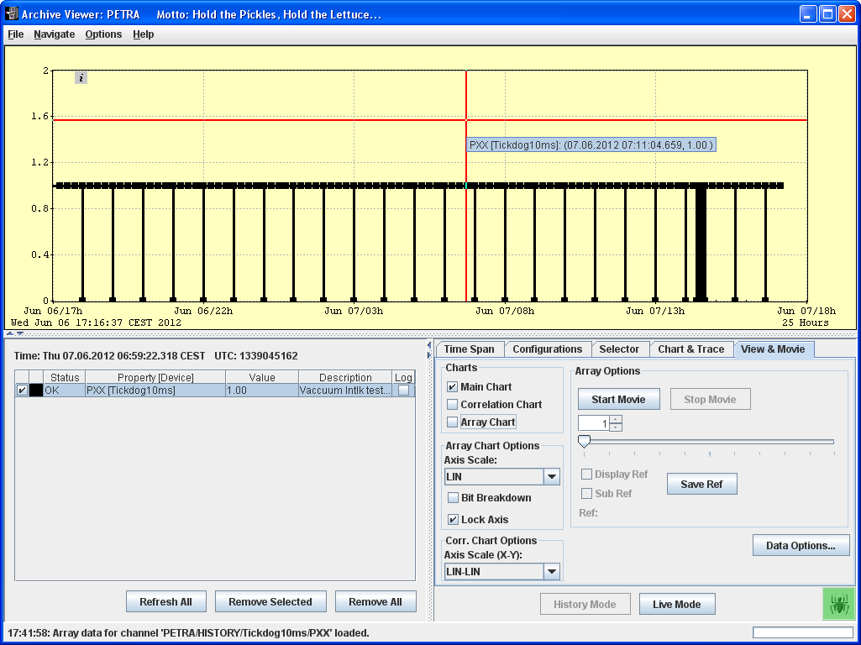
Archive System
Catching Events in the central archive
Tested in the HASYLAB vacuum interlock:
‘schedule a 10 ms pulse once/hr
(value = 0 for 10 ms every hour)

Slide 50
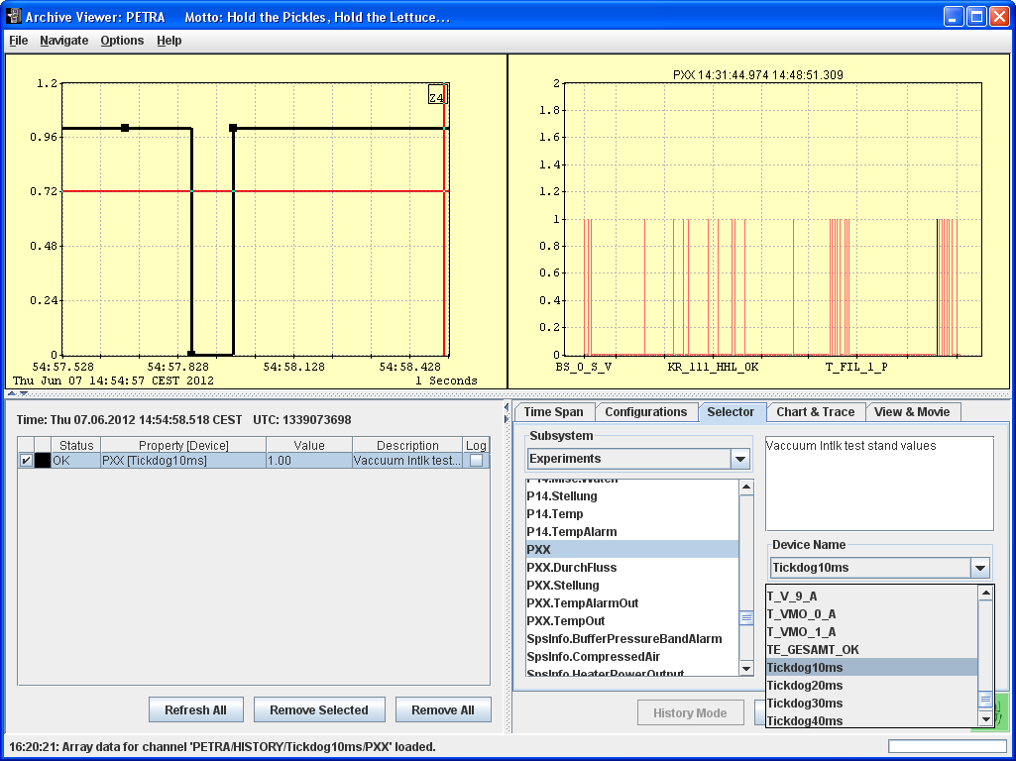
Archive System
Catching Events in the central archive
Data @ 14:54:57.691,
14:54:57.864,
14:54:57.973,

Slide 51
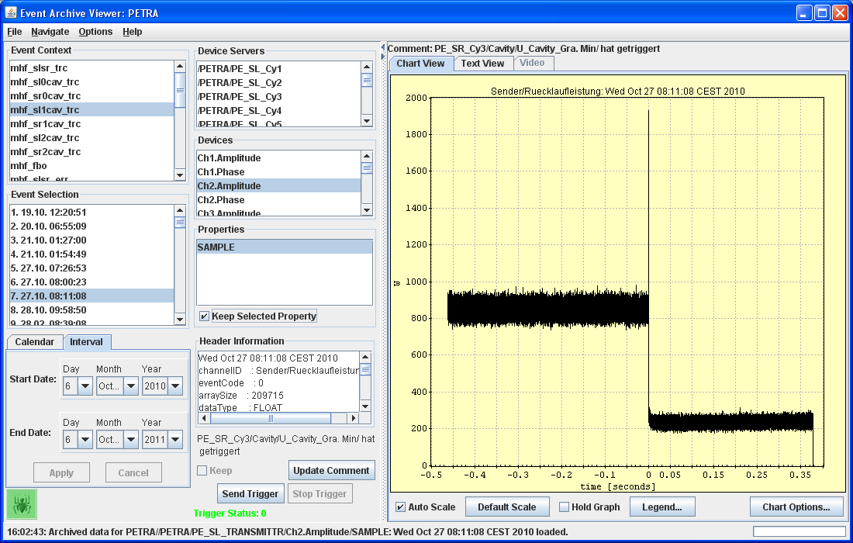
Event Archives
Generic event viewer:

Slide 52
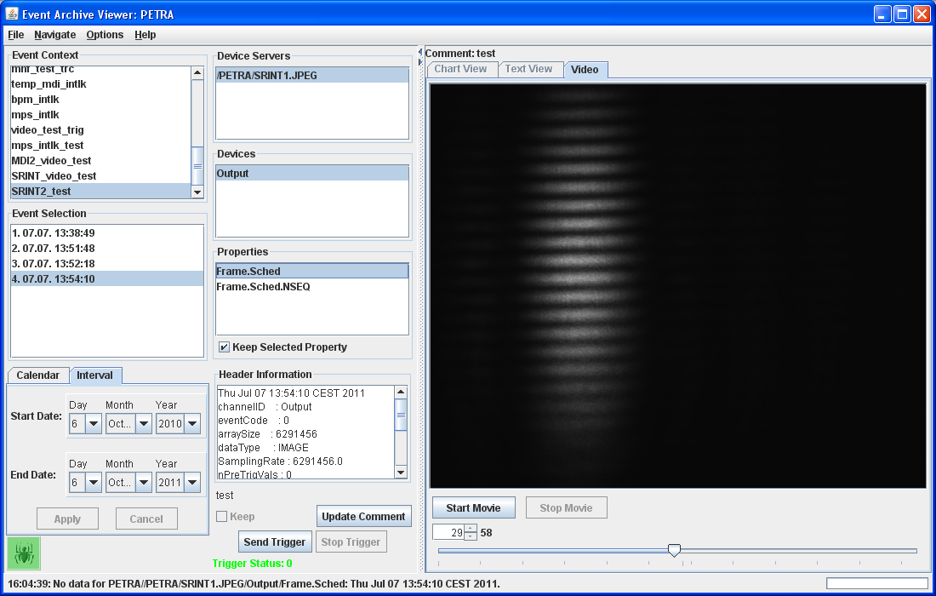
Event Archives
Generic event viewer:

Slide 53
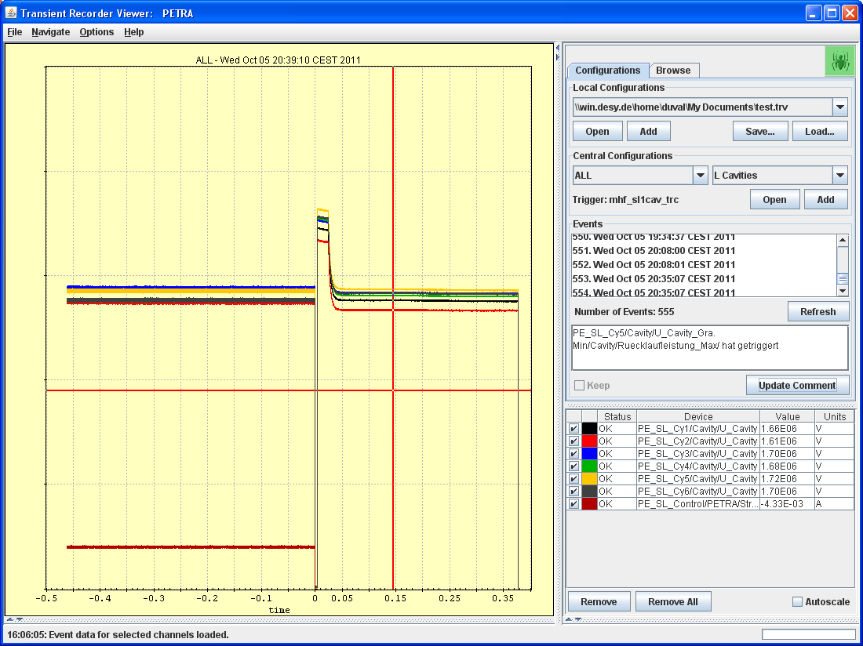
Event Archives
Transient Recorder viewer

Slide 54
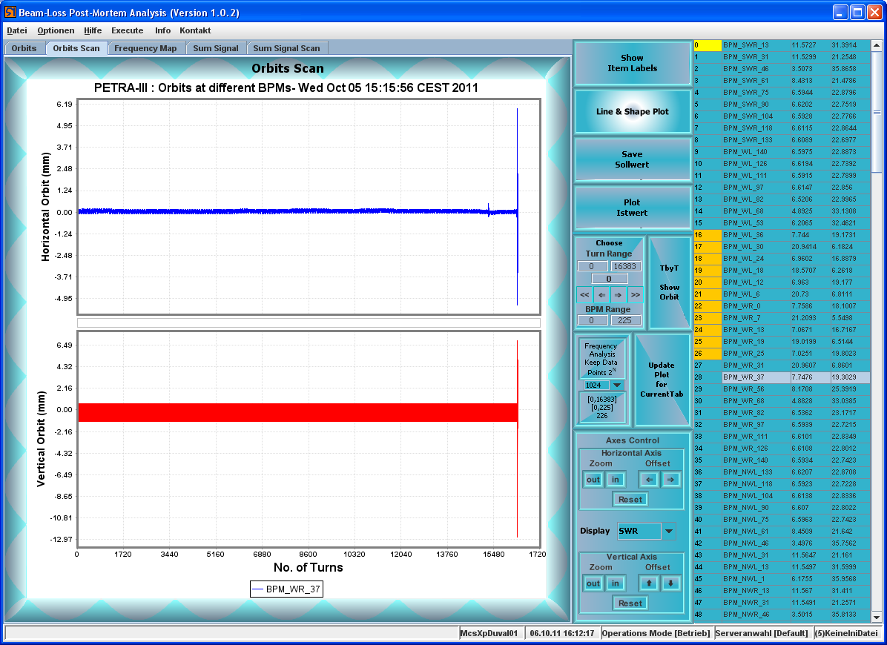
Event Archives
BPM Event viewer

Slide 55
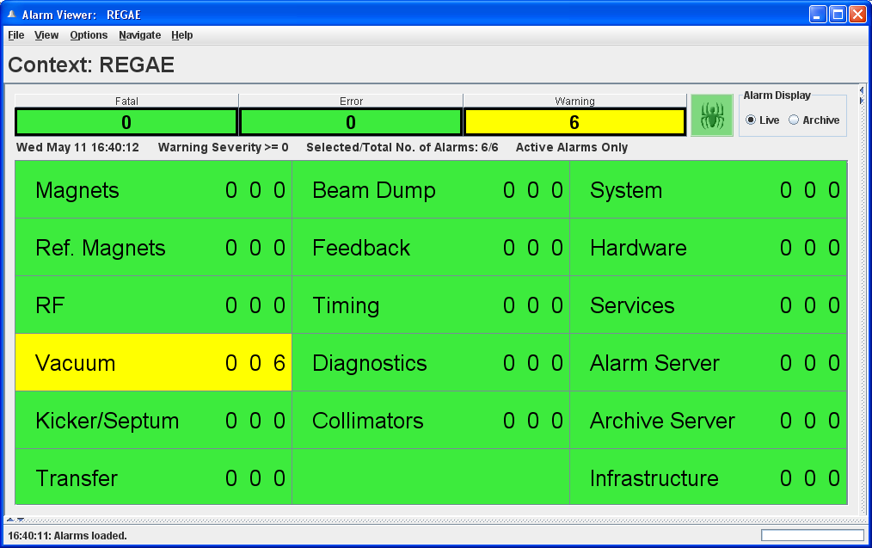
TINE Alarm System
Compact Overview
Detailed view

Slide 56


TINE Alarm System
Detailed view:

Slide 57

Operations + Availability
(typical day at DESY2 …)

Slide 58

Operations + Availability
(typical day at DESY2 …)

Slide 59
Development Tools
The Instant Client
  Browse the entire control system
  Address and display any element
    Change the settings if you get through security !
  Primary utility for testing your brand-new server
‘attachfec’ utility
  attach to a FEC process
    FEC = Front End Controller -> container for 1 or more servers
    on the local host via named pipe
    remotely via debug socket
  check on settings, connection tables
  monitor all i/o (at multiple debug levels)

Slide 60

The Instant Client

Slide 61

The Instant Client

Slide 62

The Instant Client
‘escape’ the characters that belong to the string !

Slide 63

Debugging Utilities: attachfec
Server Problems
  Make use of attachfec as a general rule.
    Windows: GUI
    Unix: command line tool
  ‘local pipe’
    does not involve the network
    attachfec must run on same host as the FEC.
  ‘remote stream’ connects via a dedicated TCP socket.

Slide 64

Debugging Utilities
e.g. attachfec /REGAE/Mag.Corr
very useful !

Slide 65

Debugging Utilities
get clients
get client(2)
get contracts
get contract(7)

Slide 66
Debugging Utilities
Server can register its own console commands !

Slide 67

Debugging Utilities
General overview of all servers :

Slide 68
Conclusions
Powerful Framework
  Many useful tools, services, servers right ‘out of the box’ (and more to come!)
Mature but still evolving control system
Multi-platform
Scalable to large machines
Multiple data-flow paradigms
Easy to setup and use !
Is expanding its culture base !
  e.g. ‘scripts’ are more popular at the beamlines than at the accelerator
  (thanks for your help, EMBL-Hamburg!)
What to expect:
  should work ‘as advertised’.
    but pay attention to firewall settings, etc.
  some extreme scenarios might require ‘tweaking’ or knowing what is going on.
    e.g. video server : multicast 53 MB/s on gigabit network, 20 Hz, 2.7 MB/image (<1% drop) (pay attention to your network hardware!)
Forum: http://tineforum.desy.de
Bug Reports: http://tinetracker.desy.de

Slide 69


TINE : Where to get it …
http://tine.desy.de
  Visit the download section and chose your platform.
  Use setup tools available.
  Installation takes a few minutes
  Don’t expect too many miracles (you might have to read a README.txt or two).
email to tine@desy.de

