Slide 1
TINE Core Meeting
2.8.2018

Slide 2
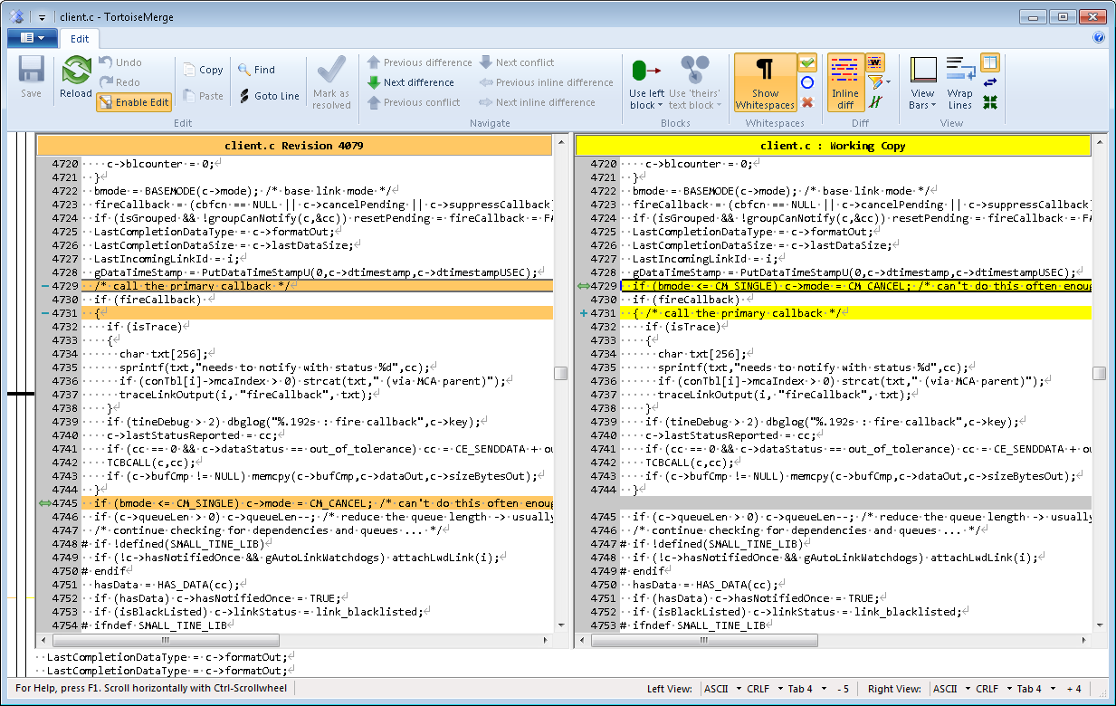
4.6.3 Fixes and Features…
In NotifyClient() (client.c) :
Unit stress test failing with too many link timeouts (TCP/STREAM mode)

Slide 3
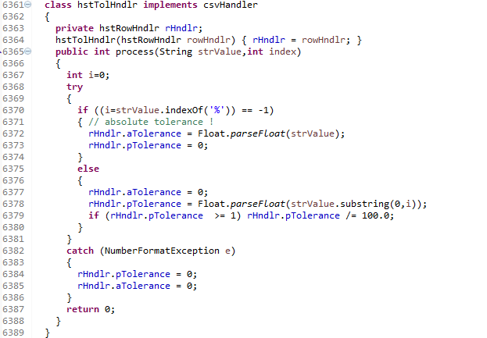
4.6.3 Java
Local History relative tolerance.

Slide 4
4.6.3 Java
TLinkFactory.userType (String)
In advance of Release 5.0 :
=> jddd Workarounds only apply to actual jddd clients !

Slide 5
Odds and Ends
Tutorials
Interest in tutorials (Python, Acop.NET, ?)
Acop.NET News
AcopForm, 3-D charts, etc.
PCaPAC presentation as early alpha @ Wednesday meeting in a few weeks; as beta @ TINE Users Meeting in September …
Central Archive News:
Master/Slave role reversals …
PETRA, XFEL
Coming soon: anybody else?

Slide 6
Release 5.0
Release 5.0 …
Preliminary versions (C and Java) in SVN.
C Unit Client and Servers tested (with even more tests!)
R5 server – R5 client
R5 server – R4 client
R4 server – R5 client
Java server and clients tested
No ‘java unit server’
Numerous unit tests by hand …

Slide 7
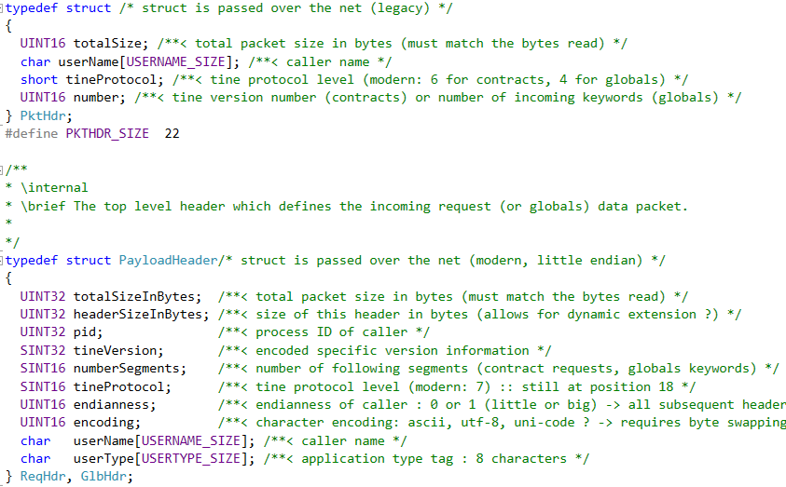
Release 5.0 Transport headers

Slide 8
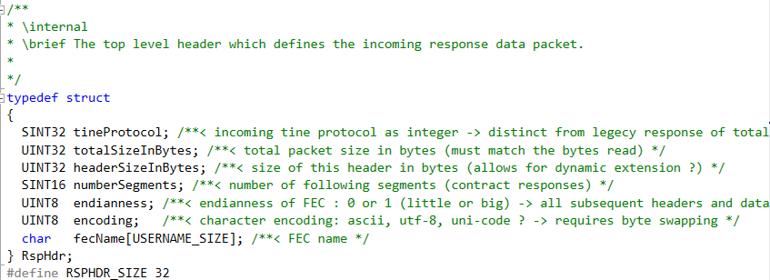
Release 5.0 Transport headers
Response (Server -> Client)
Legacy: just single unsigned short with sizeInBytes …
Modern:

Slide 9
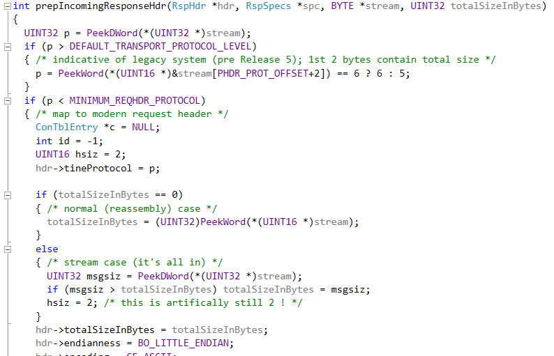
Release 5.0 Transport headers
Handling legacy responses :

Slide 10
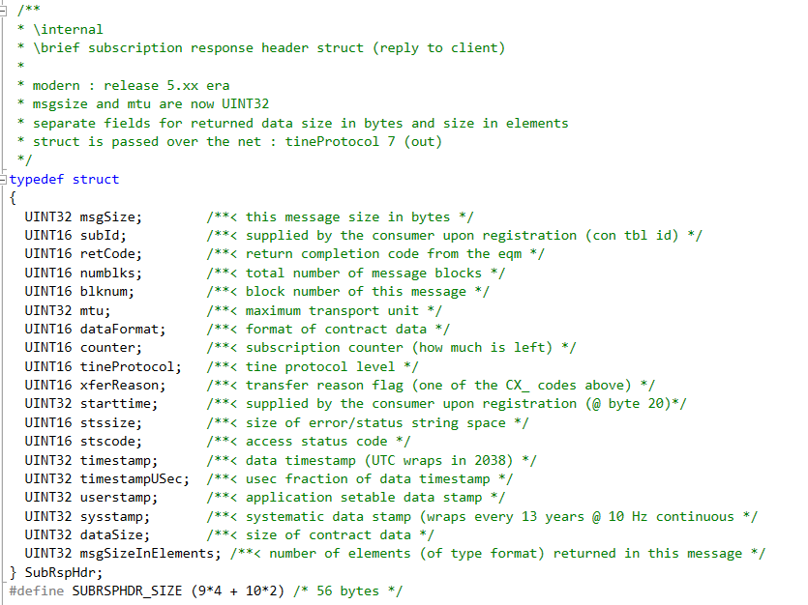
Release 5.0 Transport headers
Subscription header(s) follow the Response header:
sysstamp and userstamp still 32-bit integer and NOT 64-bit integer.

Slide 11
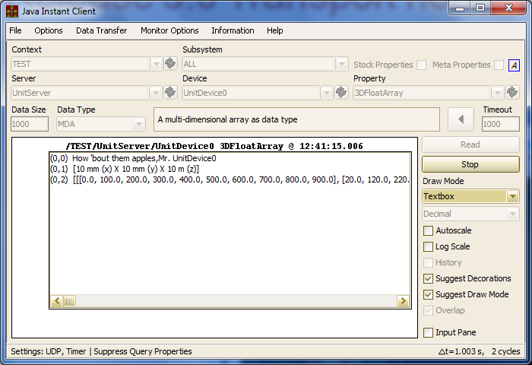
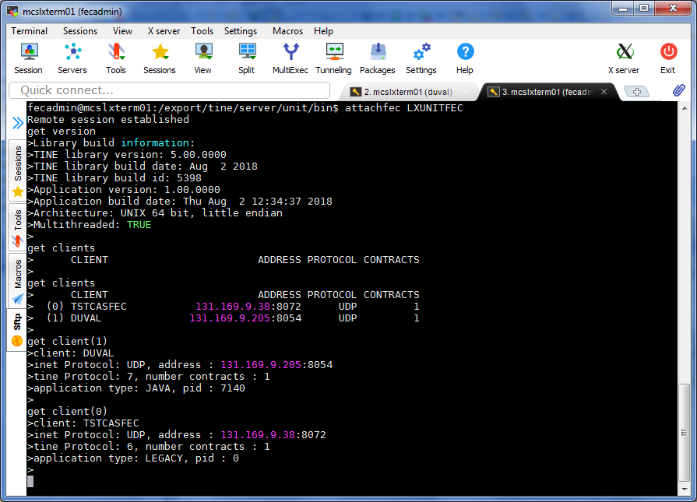
Release 5.0 Transport headers
Release 5 java client
Release 5 C server …

Slide 12
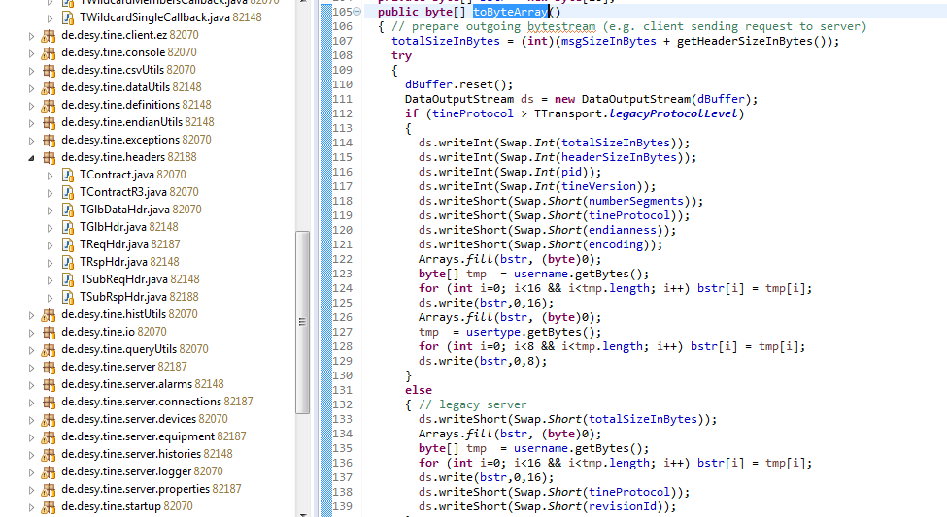
Release 5.0 Transport headers
Java: same transport headers and compatibility must be present!

Slide 13
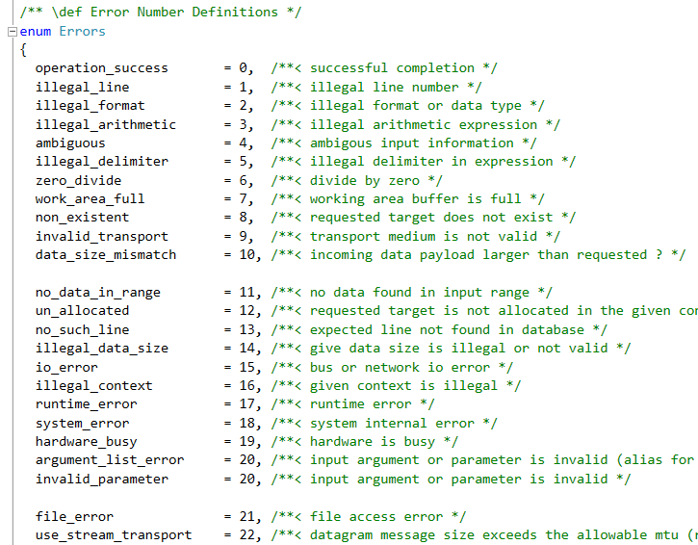
Release 5.0 Transport headers
Other embellishments …
C side:
Many macro #defines (which have been around since ‘the beginning’) have moved to enums
Many macros -> functions
Forget about being nice to MS-DOS !

Slide 14
Release 5.0 Transport headers
C Side:
No more clashes with STL or MFC headers !
Works with or without namespace wrapper
namespace tine
{
#include “tine.h”
}

Slide 15
Release 5.0 Transport headers
C and Java:
New format types for strong typing:
CF_UINT16
CF_UINT32
CF_UINT64
Auto-grow the connection table by default.
Not yet making use of the endianness or encoding information.

