Slide 1
TINE Core Meeting
24.01.2017

Slide 2
Release Notes 4.6.0
- (RE)-CONNECTIVITY IMPROVEMENTS: Numerous improvements in handling TCP connections problems have been introduced. In addition improvements to contract reconnection with transport modes such as CM_EVENT have been introduced.
Affects: client side links, mostly those using TCP mode and/or
CM_DATACHANGE or CM_EVENT transport flags.
Possible side effects: None expected.
Attention level: GREEN
- CLEANUP IMPROVEMENTS: Overall resource and memory cleanup is now significantly improved when a dynamical (shared) tine library is explicitly unloaded from memory.
In the past, various lists and resources where left resident when a client-side application exited, with the expectations that all allocated resources are returned to the system. This is true if the application is the entity unloading the library when it exits. However, an application such as matlab or python will load the tine shared library when necessary and will unload the tine shared library if e.g. a 'clear mex' or 'del PyTine' is called. This action does not exit the application but does unload the library and leaves memory and resources unaccounted for (a memory leak) until e.g. matlab or python are themselves exited.
As of release 4.6.0 this is no longer the case: a 'clear mex' or 'clear tine' will unload the tine library and return all memory an resources to the system.
Note: There was no memory leak involving the tine library under normal operational conditions.
Affects: MatLab, Python and other applications explicitly freeing the tine resources.
Possible side effects: None expected.
Attention level: GREEN

Slide 3
Release Notes 4.6.0
- BUG FIX: An alarm system 'collapsed alarm' (which occurs when more than the configured 'collapse window' - default = 100 - alarms are active) is now property removed when the number of alarms returns to fewer than the 'collapse window'.
Affects: Alarms readout via the 'ALARMS' stock property.
Possible side effects: None expected.
Attention level: GREEN
- BUG FIX: An alarm or history filter link which attempts to establish a link to 'itself‘ (i.e. a property exported by the very same server applying the filter link) now functions properly.
Previously, the application of the filter links could potentially happen (dependent on the server's configuration method) prior to the server's property registration, which ended up invalidating the link. This scenario has now been addressed.
Affects: Local alarm or history filter links.
Possible side effects: None expected.
Attention level: GREEN

Slide 4
Release Notes 4.6.0
- BUG FIX: BUFFERED SERVER : A longstanding problem buffering individual input values for a declared multi-CHANNEL array registered to take a single value as input has been fixed.
An independent buffer with space for all devices making up the channel is now properly maintained, as is the case for non-CHANNEL (i.e. SPECTRUM or COLLECTION) arrays.
Affects: Interfaces making use of the buffered server and CHANNEL arrays.
e.g. LabView, Python, or MatLab servers.
Possible side effects: None expected.
Attention level: GREEN
- New Feature: The API call SetConnectionTableCapacity() is now 'dynamic'. Meaning: it can be called at any time (not just at initialization) and will accordingly re-allocate the connection table memory if the capacity is increased.
Affects: The client-side connection table size.
Possible side effects: None expected.
Attention level: GREEN

Slide 5
Release Notes 4.6.0
- New Feature: A new structure field 'NumCalls' has been added to the activity query structure (used in the stock property ACTIVITY). One can easily see the total number of times a server's equipment modules has been called (by external clients) by examining this value.
Affects: Stock property ACTIVITY
Possible side effects: None expected.
Attention level: GREEN
- New Feature: A windows client and server on the same host can now make use of so-called 'Jumbo' transmissions. Either by making use of the API call SetMMFMessageSize() or (better) the environment variable TINE_MMF_MESSAGE_SIZE a client and server can agree on the maximum size of a shared memory transfer.
Caveats: The client and server MUST agree on the MMF (memory mapped file) message size.If the assignment is larger than the default value of 65535 bytes then all shared-memory transmissions will use 'jumbo' mode, whereby no contract payload can exceed the assigned MMF message size.
Affects: windows client/server on same host.
Possible side effects: None expected.
Attention level: GREEN
- New Feature: The local history subsystem now supports 'annotations'. Local history annotations refer to the entire device server and are not specific to any particular local history record. In conjunction with this new feature, the stock properties HISTORY.CMT and HISTORY.CMTS are also available.
Affects: Local history subsystem
Possible side effects: None expected.
Attention level: GREEN

Slide 6
Reconnection @ high rates
Normally:
1 Hz => Subscription package = 60 transfers
Subscription ‘counter’ decremented for each transfer
Counter = 10 -> signal for re-subscribing from client
@ higher rates => ‘renewal multiplier’ based on N Hz vs. 1 Hz.
Client does not renew -> server stops sending to him!
i.e. no ‘dangling clients’ allowed !

Slide 7
Reconnection @ high rates
What about ‘scheduling’ data at high rates?
No systematic way for server/client to know how fast the transfers are coming !
Can use SetSystemSubscritionRenewalLength() at the server.
one-size-fits-all …

Slide 8
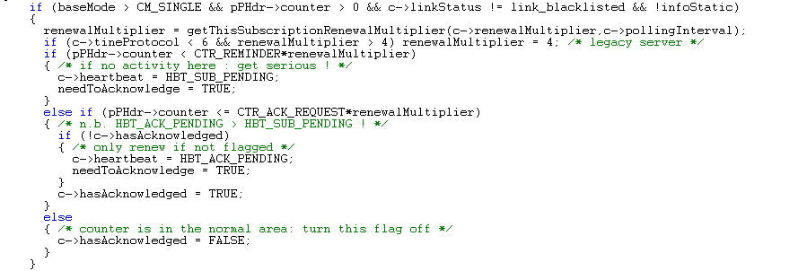
Reconnection @ high rates
Client-Side: doProcessData():

Slide 9
Reconnection @ high rates
Proposal:
Arguments okay?
linkId => user needs to note the return from AttachLink()
percent rather than some number threshold ?

Slide 10
Still To Do …
IPv6 testing
Release 5.0 …

