Slide 1
TINE Core Meeting
15.06.2017

Slide 2
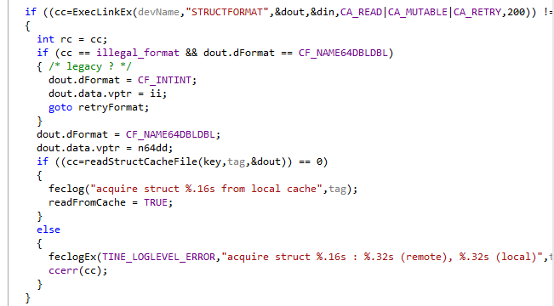
Feature Additions in 4.6.1
Add learned structure information to ‘local cache’
In toolkit.c:
(Not yet in tine.jar)
. . .
Is now in tine.jar !
. . .

Slide 3
Feature Additions 4.6.1
To do:
Need a ‘contacts’ server.
Input: ‘a follower’ or a ‘followers list’
Output: associated email address(es)
Check : if ‘follower’ is a FEC then determine the ‘responsible list’
=> a ‘follower’ could resolve to > 1 contact
Input: “send message to followers”
Output: determine the contacts list and email the message !
Andreas is working on it !

Slide 4
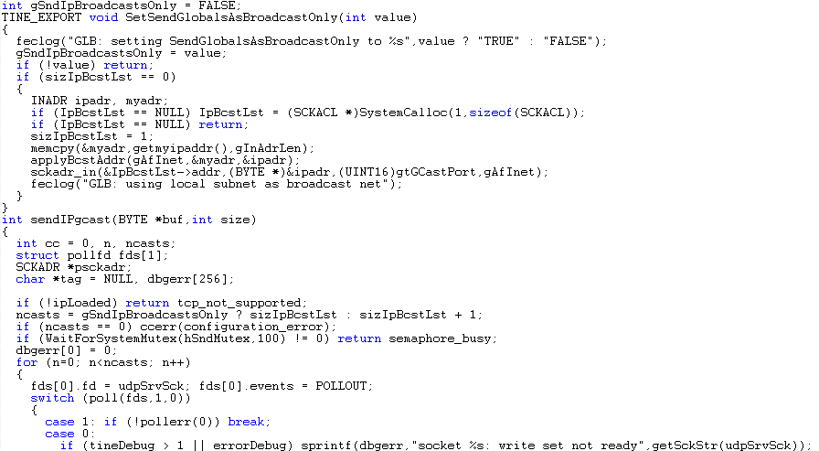
Feature Additions 4.6.1
gSndIpBroacastOnly
global variable to suppress the ‘additional’ multicast when calling sendNetGlobal()

Slide 5
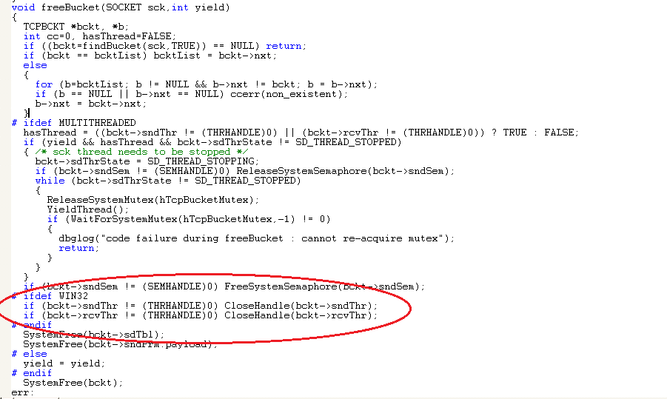
Feature Additions 4.6.1
Apply ‘CloseHandle()’ to detached windows threads

Slide 6
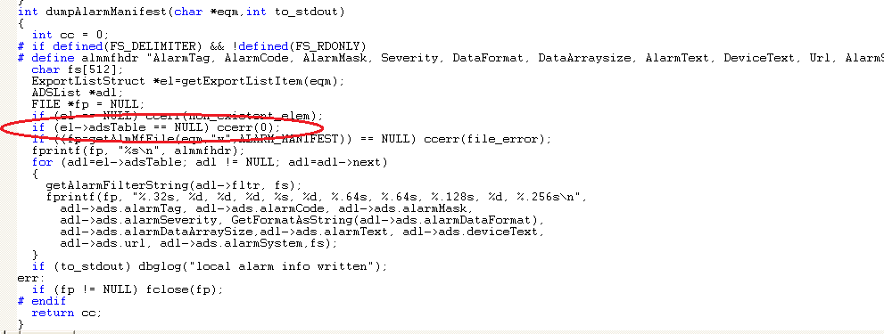
Feature Additions 4.6.1
Don’t write meaningless alarm manifest files …
The GENS suddenly had ‘zillions’ of local EQM subdirectories

Slide 7
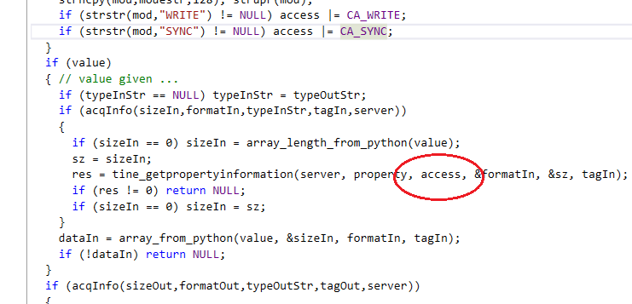
Feature Additions 4.6.1
PyTine.cpp
Fix problem acquiring property information in ‘call’ method:

Slide 8
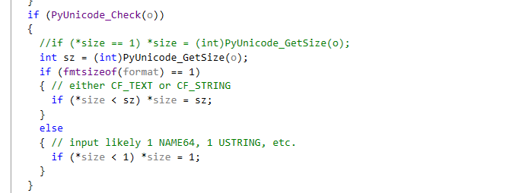
Feature Additions 4.6.1
PyTine.cpp
In ‘array_from_python()’ : fix problem determining the ‘size’

Slide 9
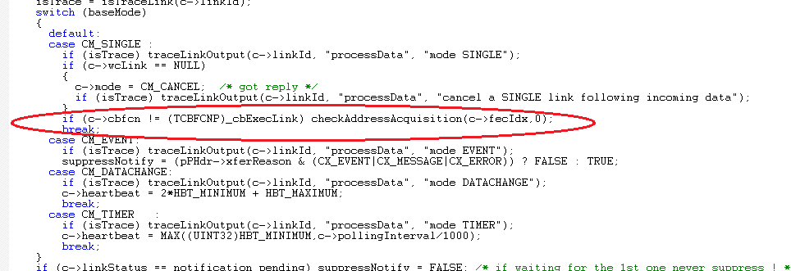
Feature Additions 4.6.1
check address re-acquisition also for asynchronous SINGLE calls !
In doProcessData() (client.c):

Slide 10
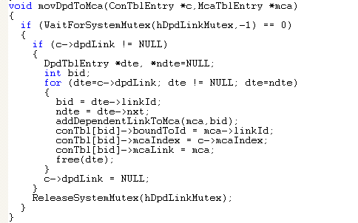
Feature Additions 4.6.1
client.c: fixed problem when identical links create a dependents lists but later discover that they are the same MCA dependents.
New routine !
doProcessData() in coercive status branch …

Slide 11
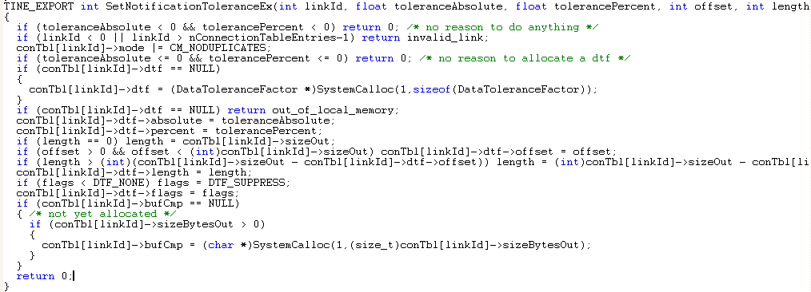
Feature Additions 4.6.1
SetNotificationToleranceEx()
Can now supply offset and length …
DTF_NOTIFY => fire callback with cc = ‘out_of_tolerance|CE_SENDDATA’

Slide 12
Feature Additions 4.6.1
feclogWriteFile: don’t log unless I’m a server !
Address acquisition failures on a pure client were writing a fec.log !

Slide 13
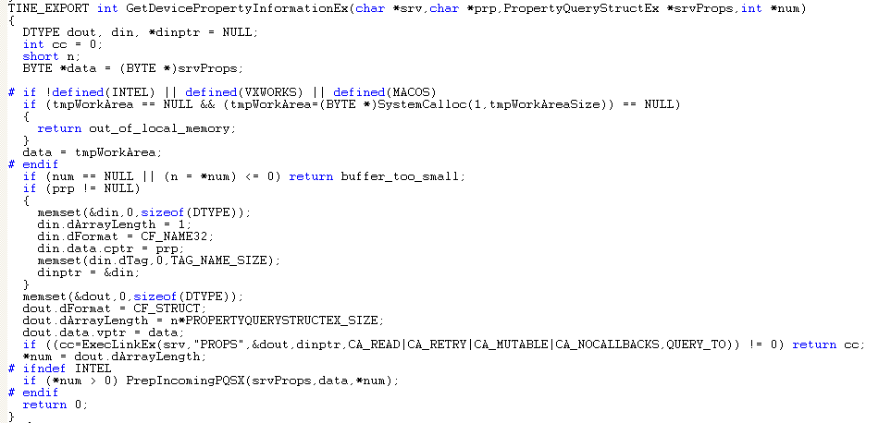
Feature Additions 4.6.1
toolkit.c
TINE_EXPORT several routines for use in .NET
Apply CA_NOCALLBACKS to query routines:

Slide 14
Feature Additions 4.6.1
Many new Acop.NET controls
Fixes and features in tine.NET DLL.
…

Slide 15
Still To Do …
IPv6 testing
Release 5.0 …

