Slide 1
TINE Core Meeting
23.03.2017

Slide 2

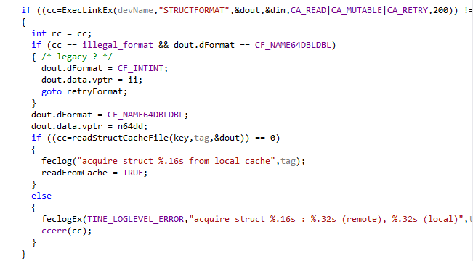
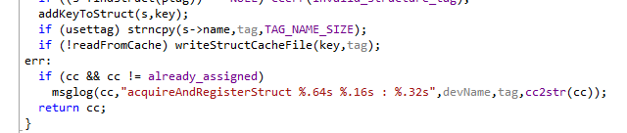
Feature Additions in 4.6.1
Add learned structure information to ‘local cache’
In toolkit.c:
(Not yet in tine.jar)
. . .
. . .

Slide 3
Feature Additions in 4.6.1
Where is the cache?
  Must be somewhere where ‘everyone’ can write !
  Windows: %SystemDrive%\tine\cache
  Unix: /var/lib/tine/cache
    NOTE: this must be ‘installed’ with ‘ugo’ +rw
    NOTE: if attempted write fails then /var/tmp/tine/cache is used
      (But this vanishes at the next reboot !)

Slide 4
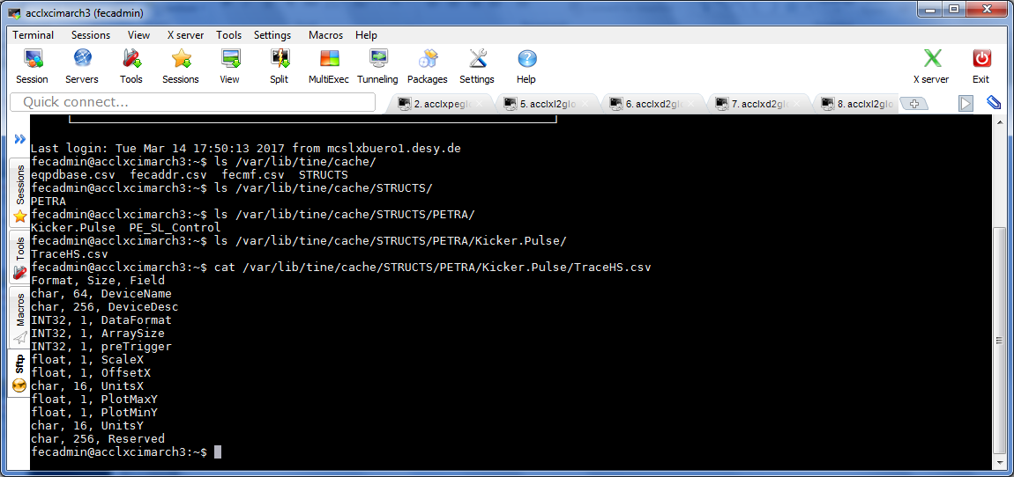
Feature Additions in 4.6.1

Slide 5
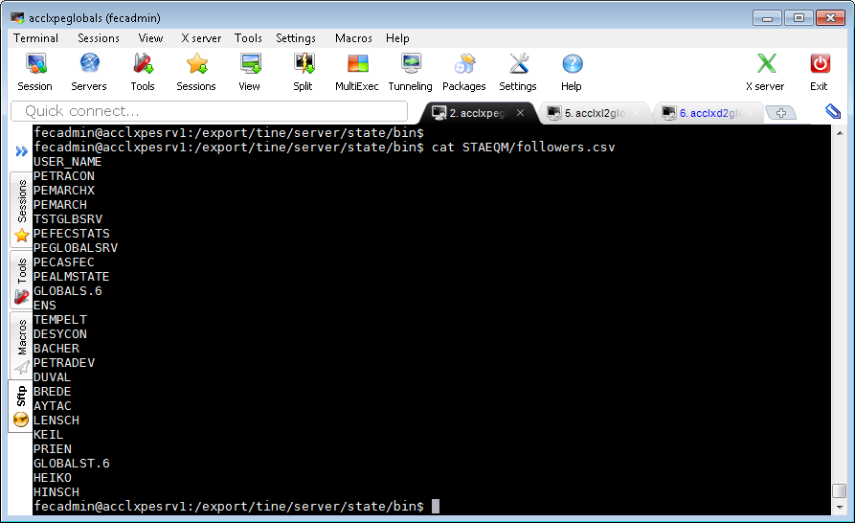
Feature Additions 4.6.1
Servers now maintain ‘followers’ list
  ‘followers.csv’ updated in the ‘EQM’ subdirectory
    FEC_HOME/<EQM>/followers.csv
  Updated with the addition of any new client.
  e.g.:

Slide 6
Feature Additions 4.6.1
To do:
  Need a ‘contacts’ server.
    Input: ‘a follower’ or a ‘followers list’
    Output: associated email address(es)
      Check : if ‘follower’ is a FEC then determine the ‘responsible list’
      => a ‘follower’ could resolve to > 1 contact
    Input: “send message to followers”
    Output: determine the contacts list and email the message !

Slide 7
Notable Bug addition and fix
Problem: a ‘group member’ list index changes
  Group members are redirected via the GENS
    LLRF.DIAGNOSTICS contains members LLRF.DIAGNOSTICS.1 to LLRF.DIAGNOSTICS.53
  e.g. LLRF.DIAGNOSTICS.3 => LLRF.DIAGNOSTICS.5
  A running client might get timeouts and eventually reacquire the address for LLRF.DIAGNOSTICS.3 (not knowing that the specific device is now hosted by LLRF.DIAGNOSTICS.5)
  Address reacquisition has mutex hSrvTblMutex and now does this:
  Forces a ‘re-learning’ of the redirection information

Slide 8
Notable Bug addition and fix
BUT:
  rmvRdrInfo() call LocateExport() which again acquires hSrvTblMutex !
Not a problem when the mutex is ‘recursive’
Default:
  Windows: recursive (OK)
  VxWorks: recursive (OK)
  Posix: not recursive (NOT OK) => deadlock when this happens !

Slide 9
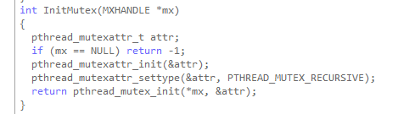
Notable Bug addition and fix
As of 4.6.1 build id 5324:
For posix mutexes:
Note: problem introduced Feb. 6 (build id 5317)
  All prior releases ‘recursive’ or not was not an issue.

Slide 10
Installation/Distribution/Synchronization
Email from U. Hurdelbrink:
ich habe festgestellt, daß die sogenannten StartControls (beim
Einloggen) alle *.bat Dateien wie z.B. WatchdogGUI.bat im Verzeichnis
C:\Users\mkibri\AppData\Local\TINE\Java löscht, die vorher über
tine.desy.de (setup.exe) installiert wurden.
Wenn man aber die StartControls disabled, gibt es kein Laufwer L: mehr.
Viele Clients schreiben aber auf Laufwerk L:
temporäre Dateien. Wenn das Laufwerk L: nicht da ist, gibt es
Fehlermeldungen.
Was kann ich machen?
Wie ist Eure Planung?

Slide 11
Installation/Distribution/Synchronization
Windows installation possibilities:
  Setup.exe (innosetup)
    All DLLs in L:\system32
    The ‘correct’ tinemt.dll in L:\system32 on path
  NetInstall (with java webstart)
    32-bit DLLs in C:\Program Files (x86)\TINE
    64-bit DLLs in C:\Program Files\TINE
    What happens with tinemt.dll ?
    .NET DLLs ?
    Start Controls -> updates local .jar libraries but not .dll libraries !
  Jaws (Jaka Webstart)
    Conflict with startup links

Slide 12
Installation/Distribution/Synchronization
Linux installation possibilities:
  Debian package for C binaries and libs (and source?)
  tar ball (tineLinux.tar.gz) with ‘setup’
    i.e. setup64 and setup => todo: just one setup
    Makes various libs and utilities
      libtine.a, libtinemt.so, etc.
      tineRepeater, attachfec, etc.
      Command line utilities (tget, tmonitor, etc.)
    Optionally makes central servers (archive, alarm, etc.)
    ‘installAsRoot’
      puts libs in /usr/lib
      puts tools in /usr/bin
      puts ‘cshosts.csv’ in /usr/etc/tine
      puts include files in /usr/include/tine
      create /var/lib/tine/cache and chmod a+x /var/lib/tine/cache

Slide 13
Still To Do …
IPv6 testing
Release 5.0 …

