Slide 1
TINE Core Meeting
15.11.2016

Slide 2
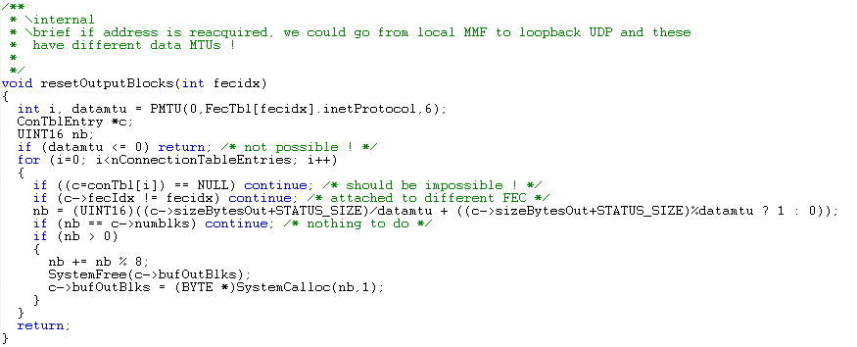
Noteworthy Changes (C-Lib)
Sept 21: introduce and use new routine resetOutputBlocks() which comes into play when a local (MMF) link goes down and comes back as a UDP loopback:

Slide 3
Noteworthy Changes (C-Lib)
re-#define SystemFree:
feclogEx() :

Slide 4
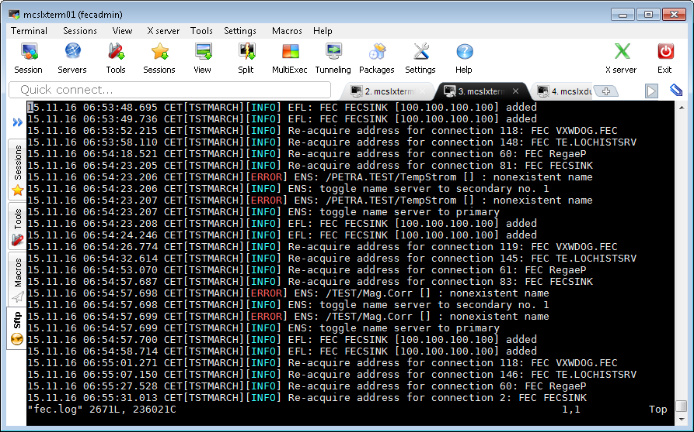
Noteworthy Changes (C-Lib)
New logging format:

Slide 5
Still To Do …
how to get and display and set (?) the alarmwatch and history filters
=> work with 'parseable' strings
=> stock property (command line also) “ALMFILTERS” (get/set almfilters)
input/output: alarm code and filter string
---> a new 'struct' (int and 256 char string) or CF_KEYVALUE (with CODE:val and FILTER:parseable string as alternating entries ?)
or: CF_STRING (with CODE:val FILTER:string) (list of atomic strings)
read: get watchtable and specific alarm filters
write: apply/edit filter for watchtable or specific alarm (first check if the target alarm is being 'watched' -> apply to watchtable; else apply to specific alarm definition)
=> stock property (command line) “HSTFILERS” (get/set hstfilters)
read: get local history filters
write: apply/edit filter for local history entry

Slide 6
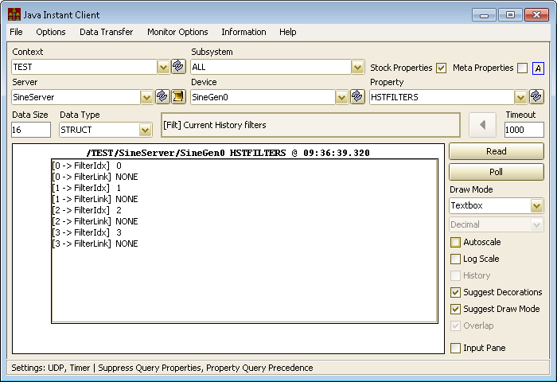
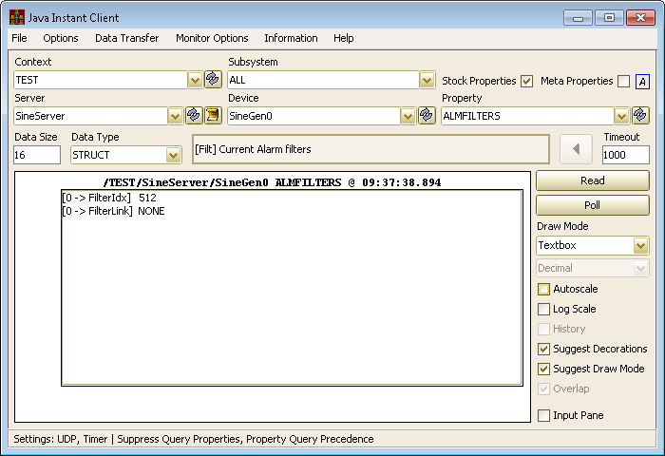
Noteworthy Changes …

Slide 7
Noteworthy Changes (C-Lib)
Solaris Build :
In ‘GetValuesAsString()’ :
Instead of :

Slide 8
Still To Do …
console command to mkhstfiles (on separate thread)
console commands to change history or alarm settings on the fly
stock handlers
local history:
add 'CF_STRUCT' + tag to the API
unix PIPE -> socket gets a 'temporarily unavailable' error !
errors.log ? a la 'commands.log‘

Slide 9
Still To Do …
IPv6 testing
Release 5.0 …

Slide 10
To do (as of yesterday):
MMF_JUMBO grams …

